Slide 1
Y6 Sats Meeting 2025

Slide 2
I am just going to explain
When the tests are
What they look like
How you (and we) can support the chidlren

Slide 3
National Curriculum Assessments (SATs)
They aren’t called SATs, its an Americanism (I think)
They are to assess your child’s learning and progress against R and Y2
They have no bearing on Secondary School
They compare your child to National Averages
They compare the school to National Averages
They are scanned and sent off to independent markers

Slide 4
Test Dates (Monday May 12th to Thursday May 15th)
Monday 12th May – SPAG paper
Tuesday 13th May – Reading paper
Wednesday 14th May – Maths paper 1 (arithmetic) and paper 2 (reasoning 1)
Thursday 15th May – Maths paper 3 (reasoning 2)
Friday 16th May - Residential

Slide 5
Reading Test
The reading test will be a single paper with questions based on three passages of text.
Your child will have one hour, including reading time, to complete the test.
There are 50 marks available. Pass mark last year was 27
There will be a selection of question types, including:
Ranking/ordering, e.g. ‘Number the events below to show the order in which they happen in the story’
Labelling, e.g. ‘Label the text to show the title of the story’
Find and copy, e.g. ‘Find and copy one word that suggests what the weather is like in the story’
Short constructed response, e.g. ‘What does the bear eat?’
Open-ended response, e.g. ‘Look at the sentence that begins Once upon a time. How does the writer increase the tension throughout this paragraph? Explain fully, referring to the text in your answer.’

Slide 7
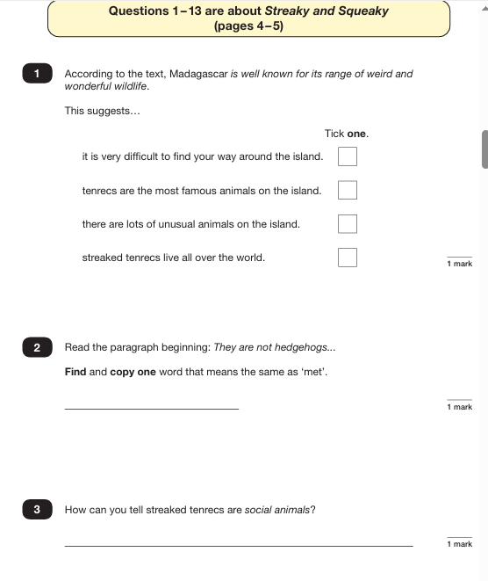
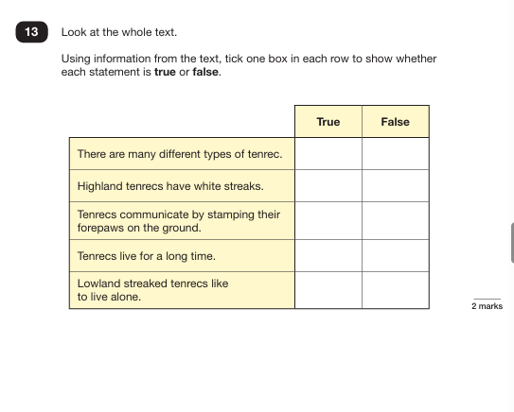

Slide 8
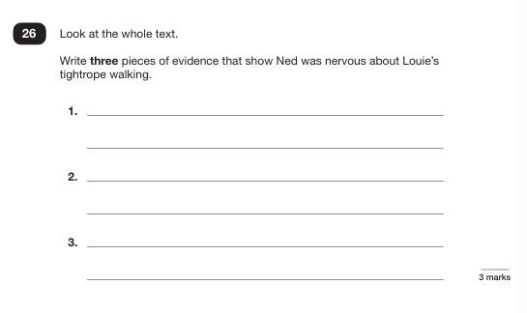
Reading Test – Papers and Example Questions

Slide 9
Maths Test
Children will sit three papers in maths:
Paper 1: arithmetic, 30 minutes. 40 marks for this paper.
Papers 2 and 3: reasoning, 40 minutes per paper. 35 marks for each papers totalling 70 for both.
The three tests will total 110. Pass marks range from 57 to 60 with last year it was 54
Paper 1 will consist of fixed response questions, where children have to give the correct answer to calculations, including long multiplication and division.
Papers 2 and 3 will involve a number of question types, including:
Multiple choice
Constrained questions, e.g. giving the answer to a calculation, drawing a shape or completing a table or chart
Less constrained questions, where children will have to explain their approach for solving a problem.

Slide 10
Arithmetic is key
There are three tests, you only need 55 or so marks (out of 110) and 40 can come from an arithmetic test.
This is why all our groups and practice each morning after Easter will be arithmetic.

Slide 11
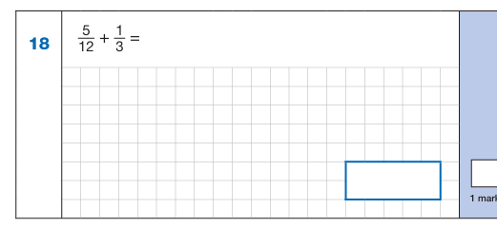
Paper 1 Arithmetic Example Questions

Slide 12
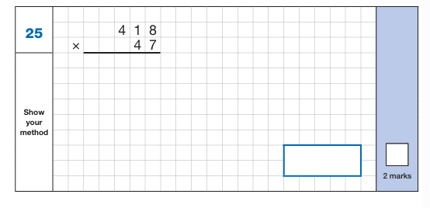

Slide 13
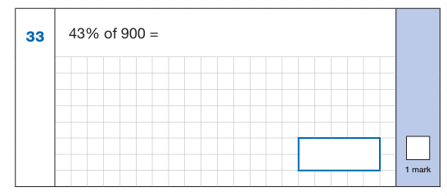

Slide 14
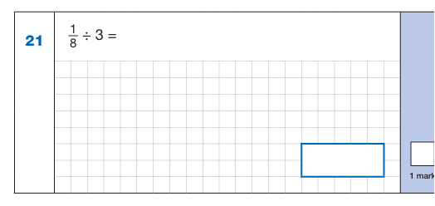

Slide 15
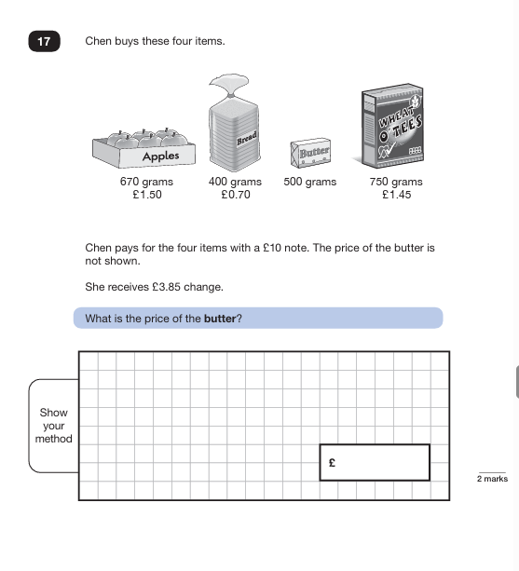
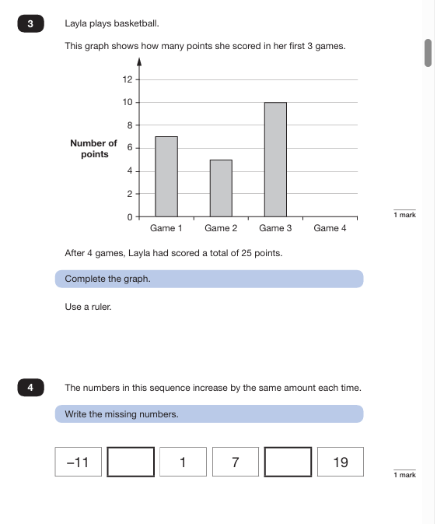
Papers 2 and 3 – Reasoning examples

Slide 16
Grammar, punctuation and spelling (SPAG)
The grammar, punctuation and spelling test will consist of two parts: a grammar and punctuation paper requiring short answers, lasting 45 minutes, and a spelling test of 20 words, lasting around 15 minutes.
Short answer paper is comprised of 50 marks, while the spelling test will be out of 20. 70 marks in total. The pass mark last year was 35
The grammar and punctuation test will include two sub-types of questions:
Selected response, e.g. ‘Identify the adjectives in the sentence below’
Constructed response, e.g. ‘Correct/complete/rewrite the sentence below,’ or, ‘The sentence below has an apostrophe missing. Explain why it needs an apostrophe.’
Every answer should have the correct spelling throughout and if the answer requires a sentence, it must be correctly punctuated.

Slide 17
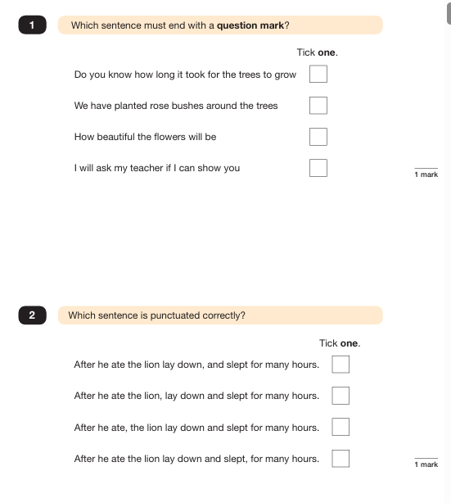
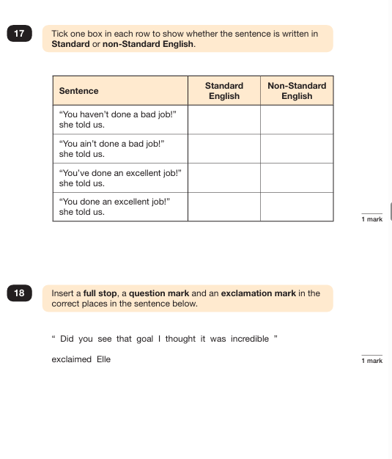
SPAG examples

Slide 18
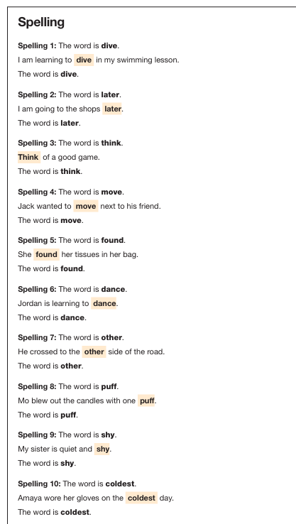
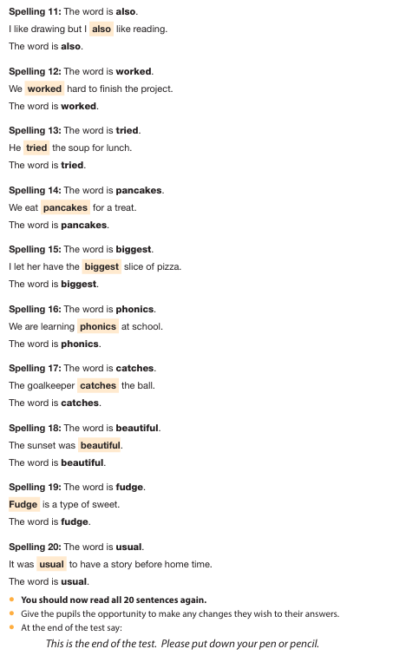
Spelling examples

Slide 19
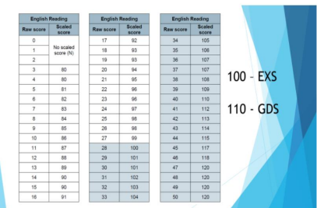
Marking and scoring
Children will be given scaled scores.
You will be given your child’s raw score (the actual number of marks they get), alongside their scaled score and whether they have reached the national average.
The scores range from 80-120. The scaled score required to achieve the Expected Standard is 100. Anything below that score has not met the expected standard. Greater Depth is classed as a scaled score of 110+.

Slide 20
Writing and Science
There is no test for writing.
End of year grades for writing will be based on continuous Teacher Assessment.
Children may be penalized if they do not join their letters correctly in the SATS tests and writing assessment.
Samples of independent work, from the Spring and Summer Terms, will be assessed by the class teachers, Senior Management Team and external moderators.
This will form the basis of an overall judgement for each child’s writing.
Science
Our school may be asked to take part in the Science Sampling tests :Weeks Commencing 6th and 13th June

Slide 21
How are we preparing the children in school?
Questions in the style of the SATs – during reading, maths and SPAG lessons.
Test skills taught during the week.
Mock tests – each term
Arithmetic Groups after school
Early morning maths after Easter – Monday to Thursday
1:1 reading and whole class reading.
Breakfast club during SATs week

Slide 22
What can you do to help you child?
Work with them, particularly on any arithmetic problems they have – usually this is just one or two areas
We will send arithmetic tests home and you can look over them
If you have a method, and the children get it right, I don’t care if it is different.
Monitor your child’s use of their tablets/phone or other hardware.
Make sure your child gets to bed early in order to get a good night’s sleep.
Ensure your child arrives at school on time every day.
Do not over work your child
Use the revision books

Slide 23
Breakfast Club
Mon – Thu on SATs Week
Healthy breakfast for all
For all Year 6 children
We will not be working, just getting them calm

Slide 24
Questions?
Mention School Trip.
Mention Hoodies.
Mention Books.

