Slide 1


Phonics
CPD
Wednesday 16th September 2026

Slide 2
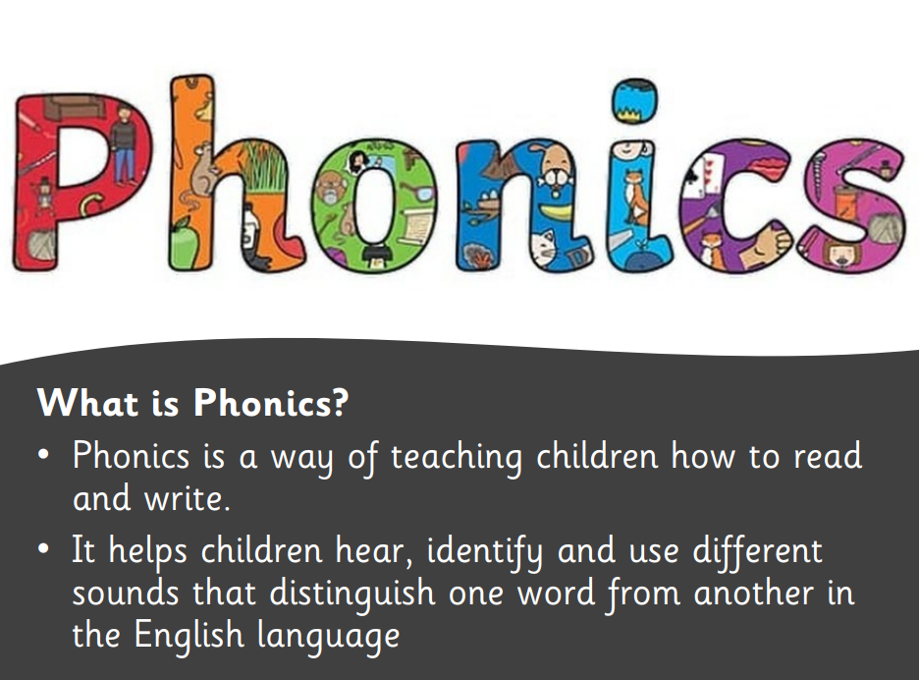

Slide 3
In school, we follow the Little Wandle programme. Little Wandle is a phonics resource published by the Department for Education and Skills.

Slide 4
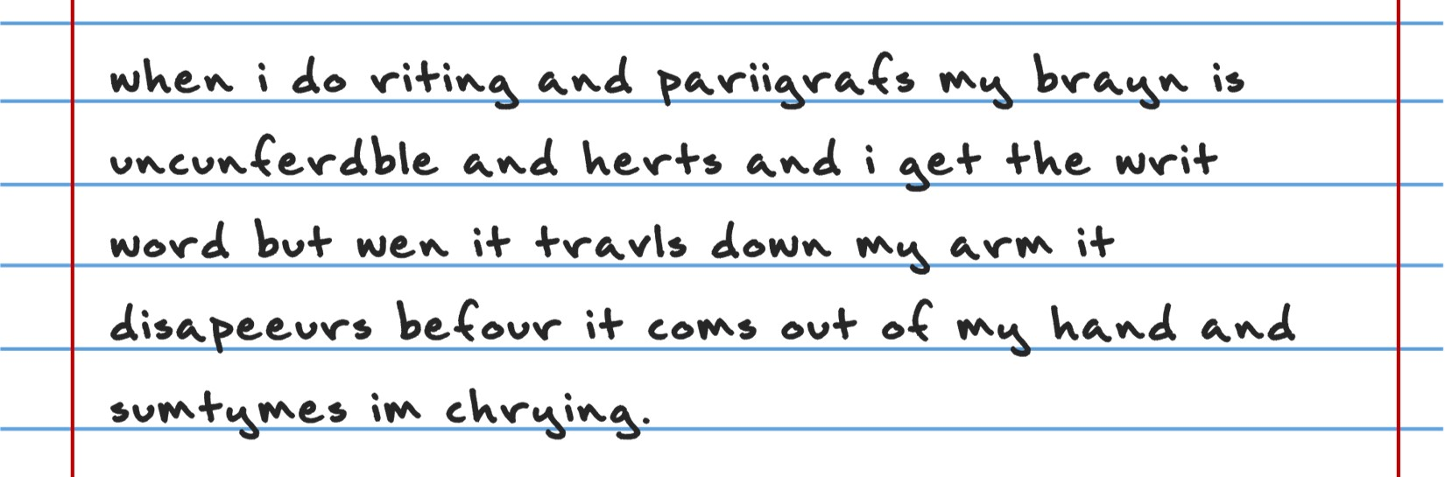
Can you read this?
What do you notice?
What would you need to know about phonics?

Slide 5
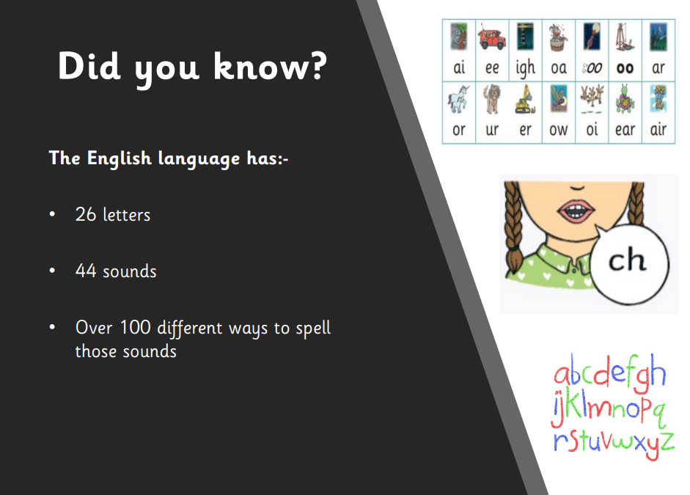

Slide 6
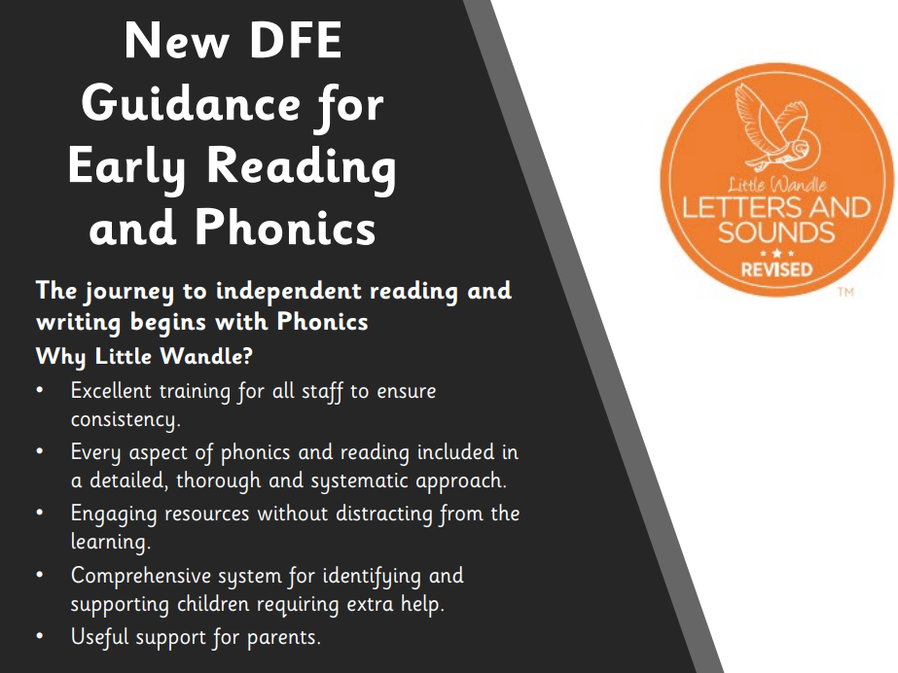

Slide 7
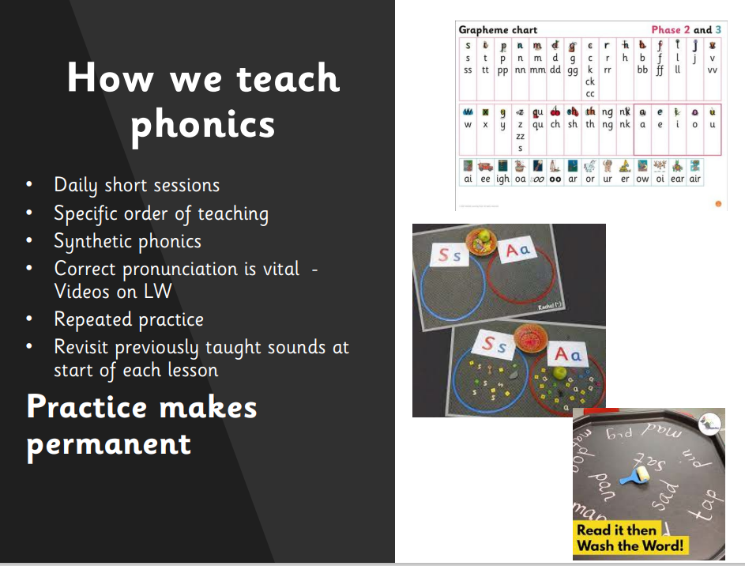

Slide 8
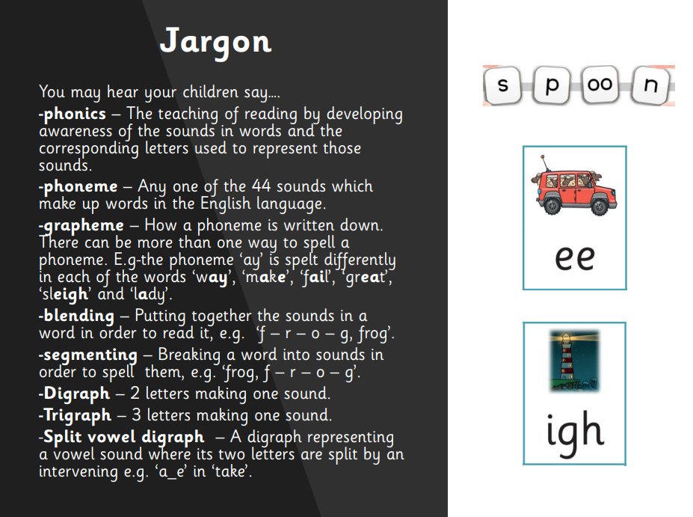

Slide 9
Phase 1
There are 7 aspects with 3 strands.
A1 – Environmental
A2 – Instrumental sounds
A3 – Body Percussion
A4 – Rhythm and rhyme
A5 – Alliteration
A6 – Voice sounds
A7 – Oral blending and segmenting.

Slide 10
Phase 2
Set 1: s, a, t, p
Set 2: i, n, m, d
Set 3: g, o, c, k
Set 4: ck, e, u, r
Set 5: h, b, f, ff, l, ll, ss

Slide 11
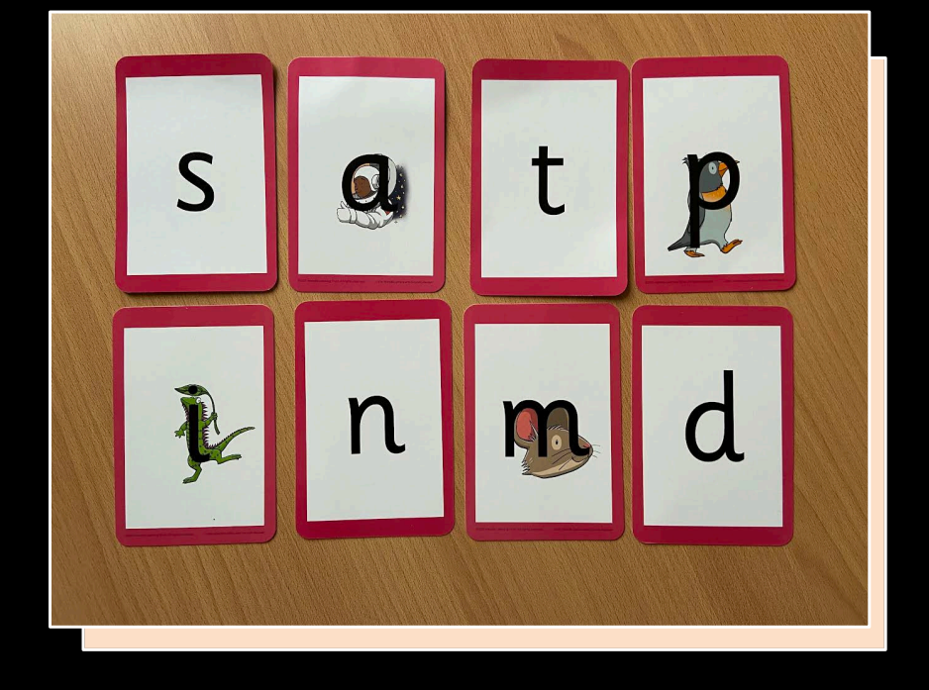

Slide 12
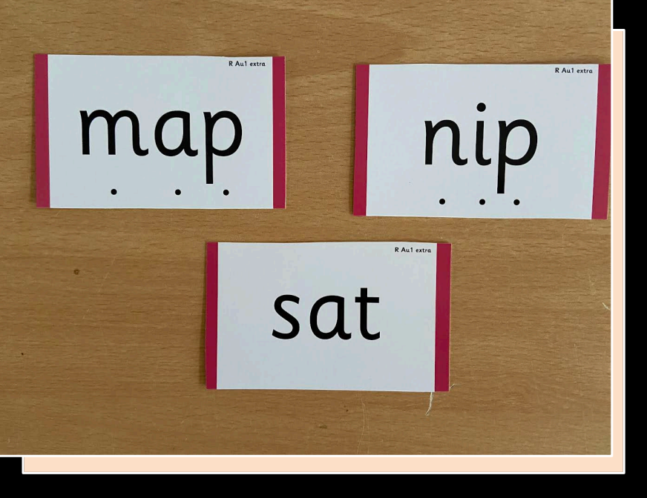

Slide 13
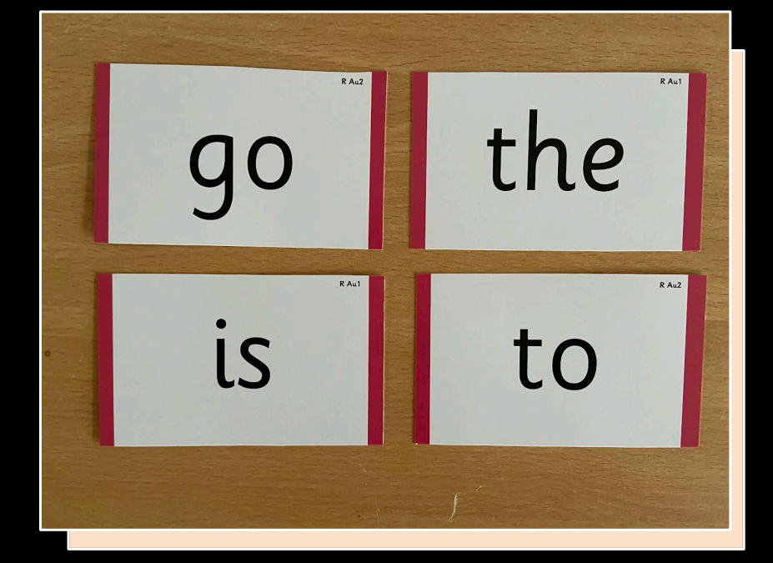

Slide 14
Phase 3
Set 6: j, v, w, x
Set 7: y, z, zz, qu
Consonant digraphs: ch, sh, th, ng
Vowel digraphs: ai, ee, igh, oa, oo, ar, or, ur, ow, oi, ear, air, ure, er

Slide 15
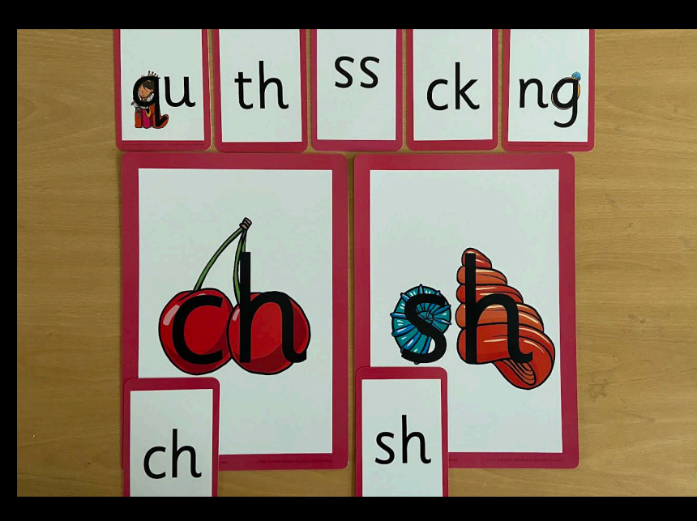

Slide 16
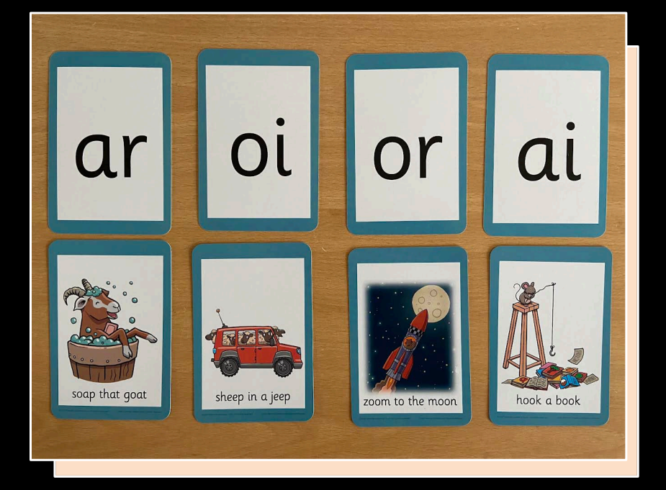

Slide 17
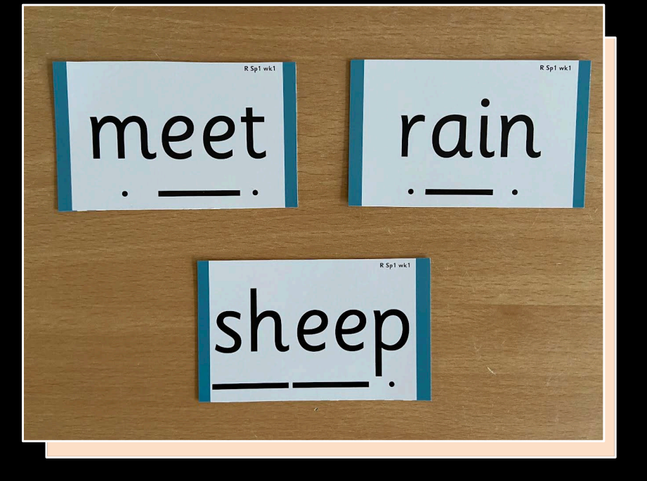

Slide 18
Phase 4
This phase consolidates all the children have learnt in the previous phases.

Slide 19
Phase 5
Children will be taught new graphemes and alternative pronunciations for these graphemes.
Vowel digraphs: wh, ph, ay, ou, ie, ea, oy, ir, ue, aw, ew, oe, au
Split digraphs: a_e, e_e, i_e, o_e, u_e

Slide 20
Phase 6
The focus is on learning spelling rules for suffixes.
-s -es -ing -ed
-er -est -y -en
-ful -ly -ment -ness

Slide 21
Segmenting
Breaking down words for spelling.
cat
c a t

Slide 22
Segmenting
Queen
qu ee n

Slide 23
Blending
Building words from phonemes to read.
c a t
cat

Slide 24
Blending
Qu ee n
queen

Slide 25
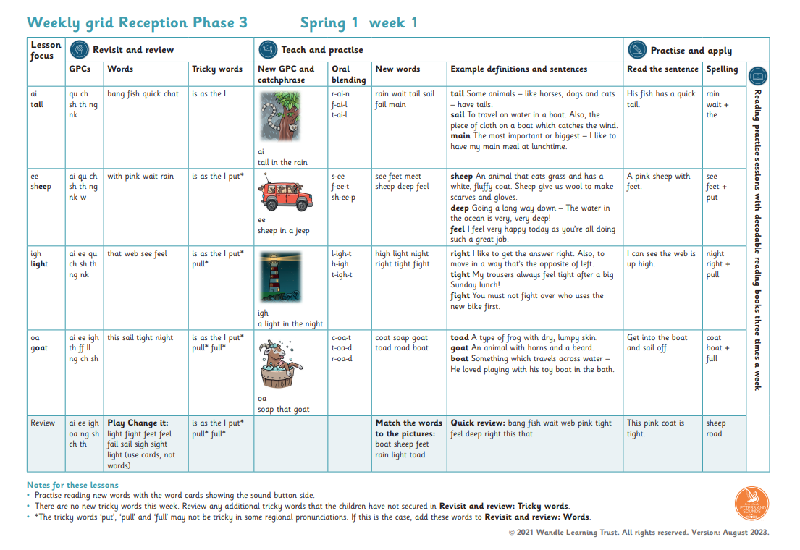
What does a Phonics lesson look like?
Revisit/review | Flashcards to practice phonemes learnt so far.
Teach | Teach new phoneme air
Practice | Buried treasure Air, zair, fair, hair, lair, pair, vair, sair, thair
Apply | Read captions: The goat had a long beard. The quack was right in his ear.

Slide 26
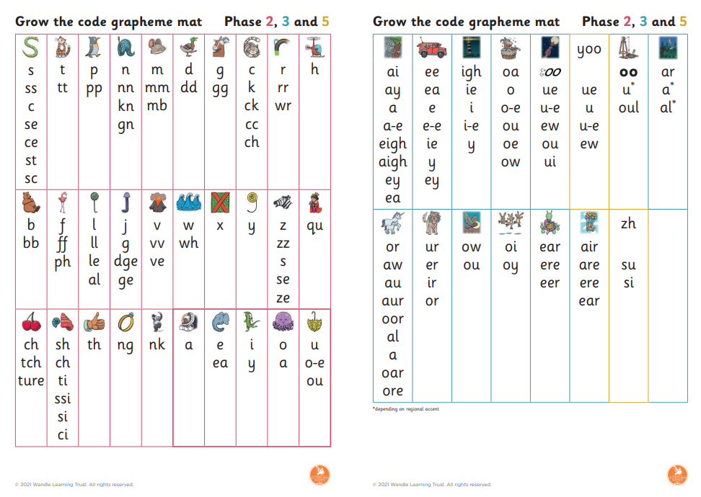
How should the sounds be pronounced?
https://www.littlewandle.org.uk/resources/for-parents/
Pure sounds- no duh, cuh

Slide 27
What can you do at home?
Flashcards- these will be given out to you
Practice oral blending
Pure sounds- pronunciation is key
Put aside time to read with your child
Act like you want to learn- children love playing the role of the teacher

Slide 28
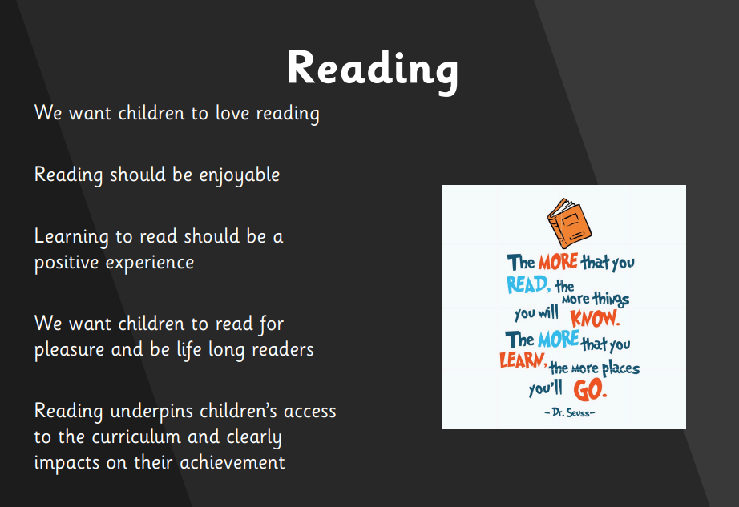

Slide 29
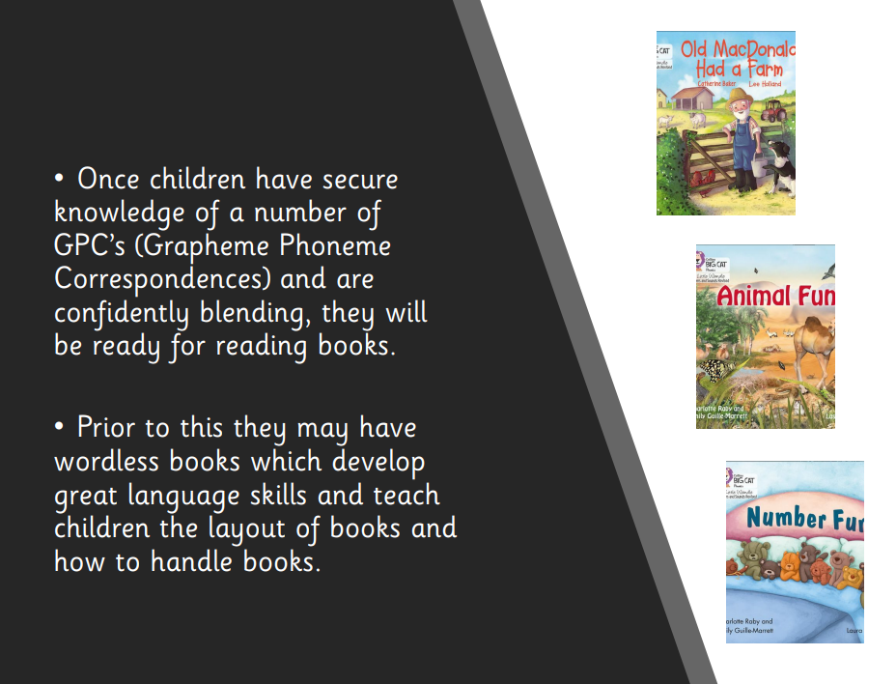

Slide 30
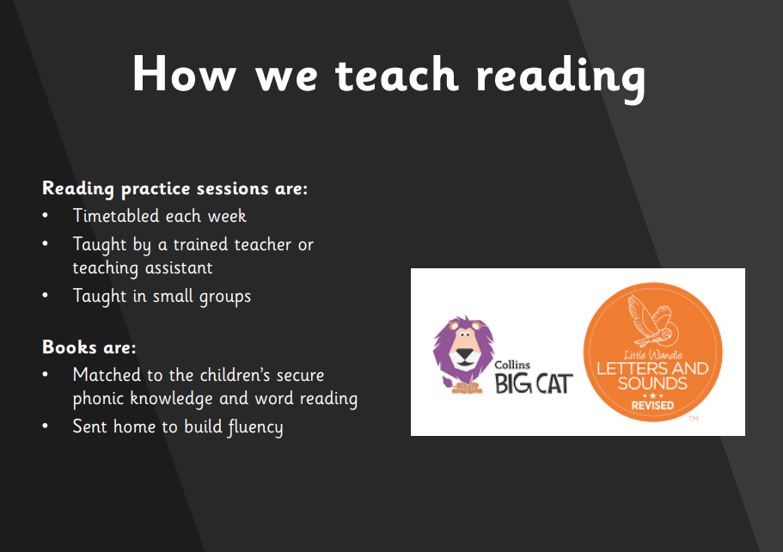

Slide 31
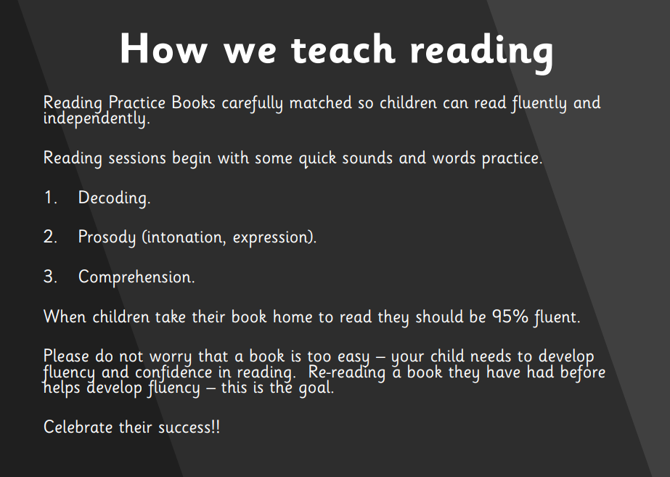

Slide 32


Slide 33

Reading at home

Slide 34
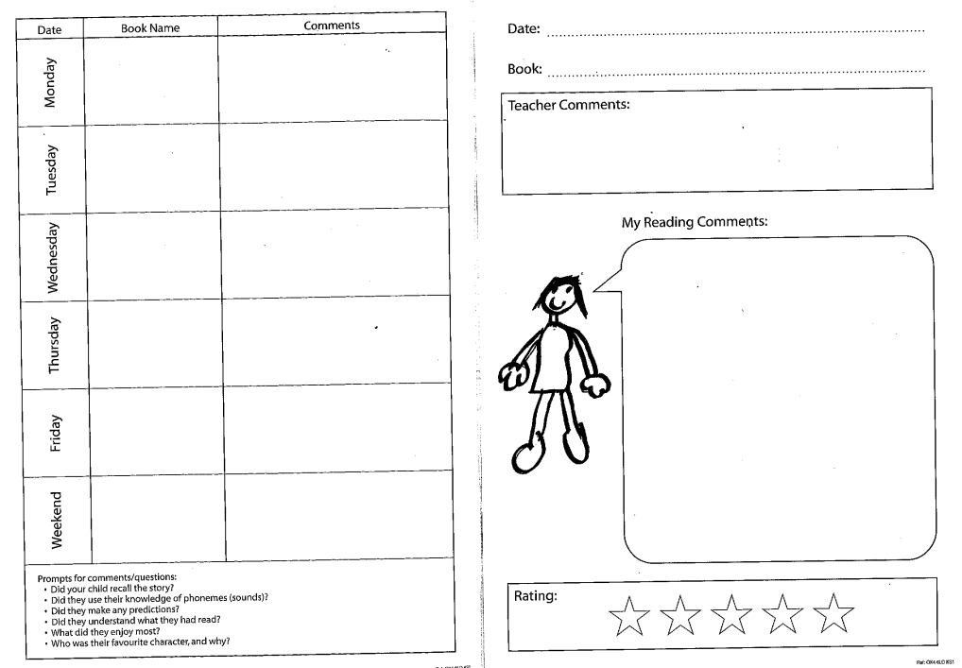
Reading at home

Slide 35
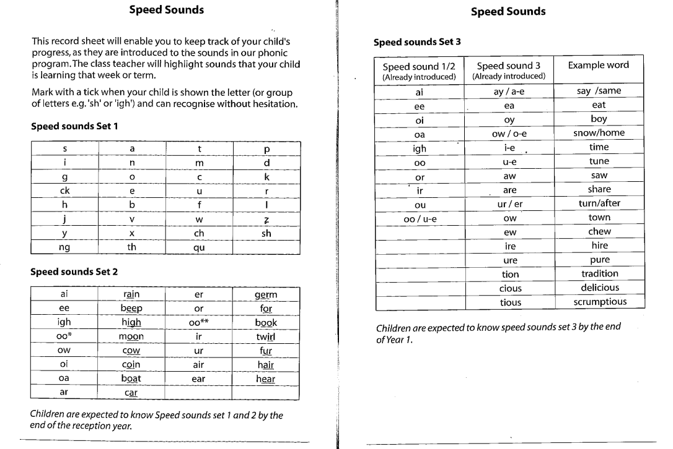
Reading at home

Slide 36
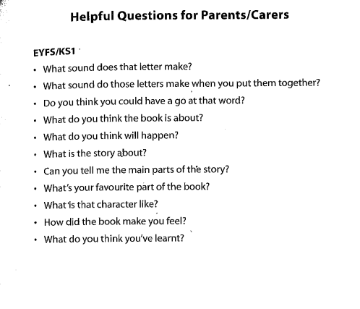
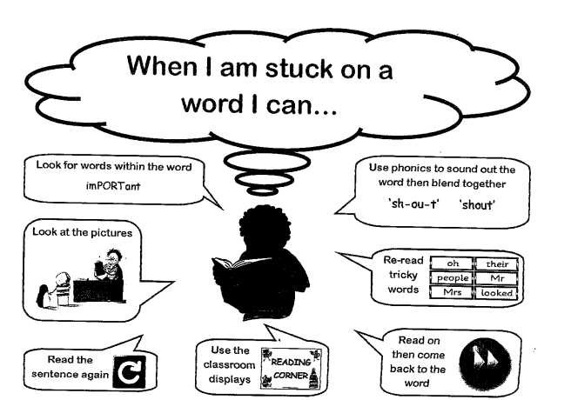
Reading at home

Slide 37
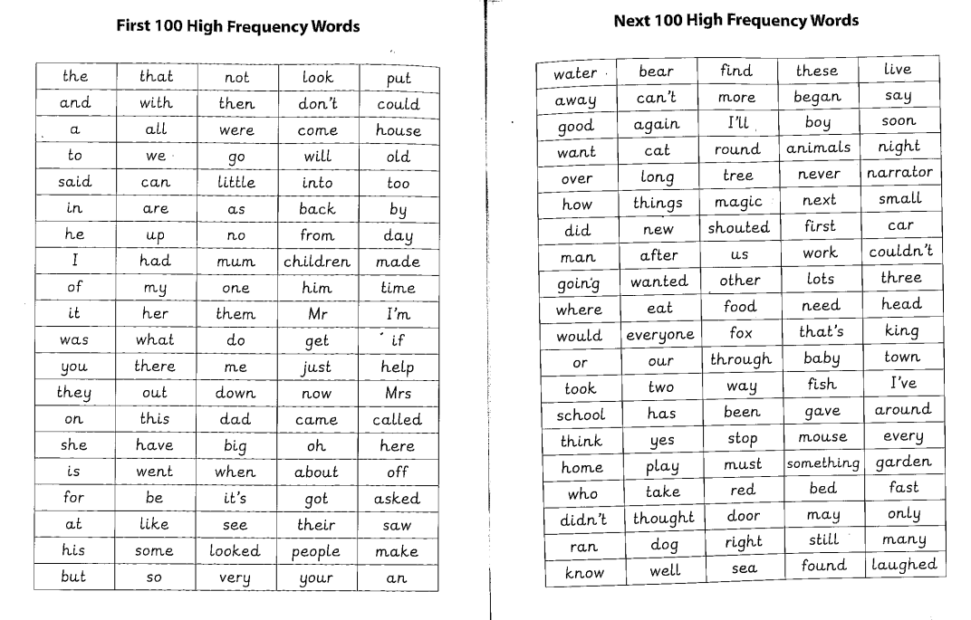
Reading at home

Slide 38
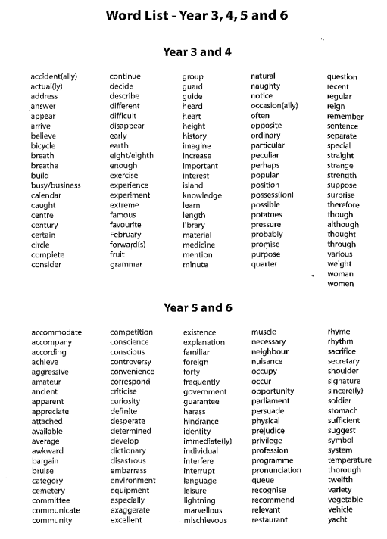

Slide 39
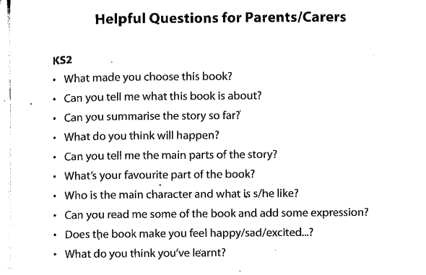

Slide 40
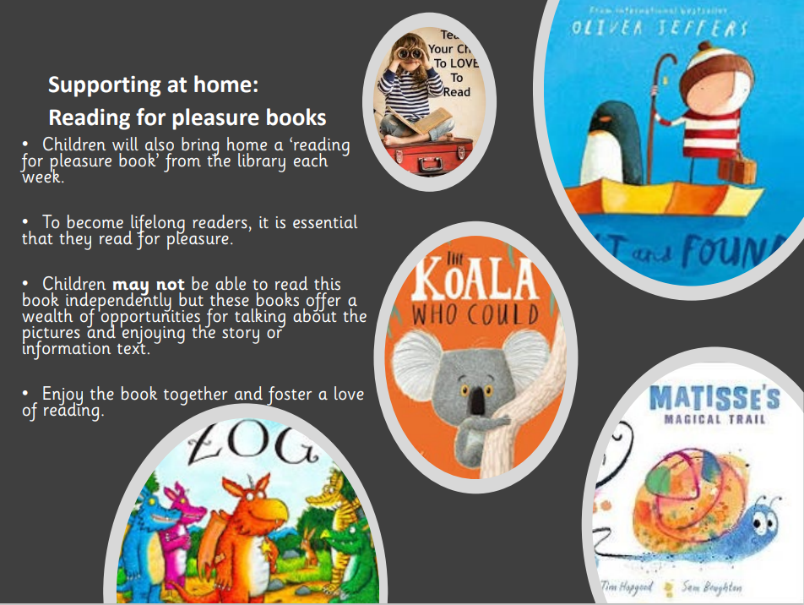

Slide 41
Reading Tree
We want to celebrate reading
Every 25 reads (1 read per day), children will receive a certificate
Every 100 reads- prize
Every 200 reads- prize
Every 300 reads-prize

Slide 42
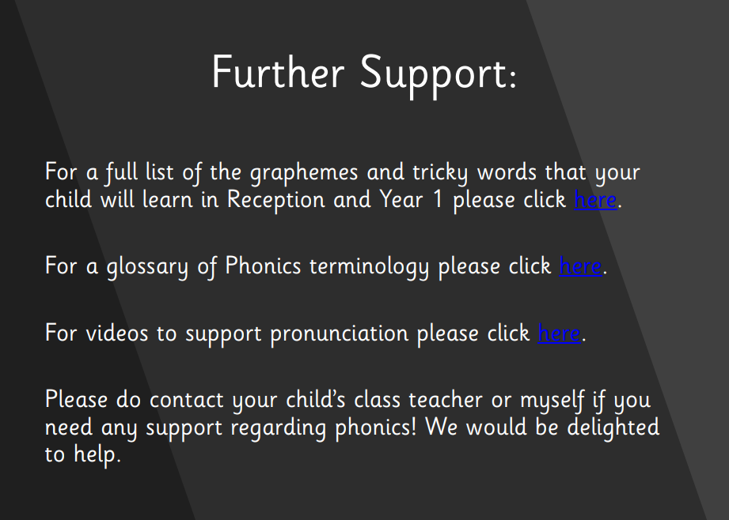

Slide 43
https://www.littlewandlelettersandsounds.org.uk/resources/for-parents/#tabnametabBooksComingHome

Slide 44


Slide 45
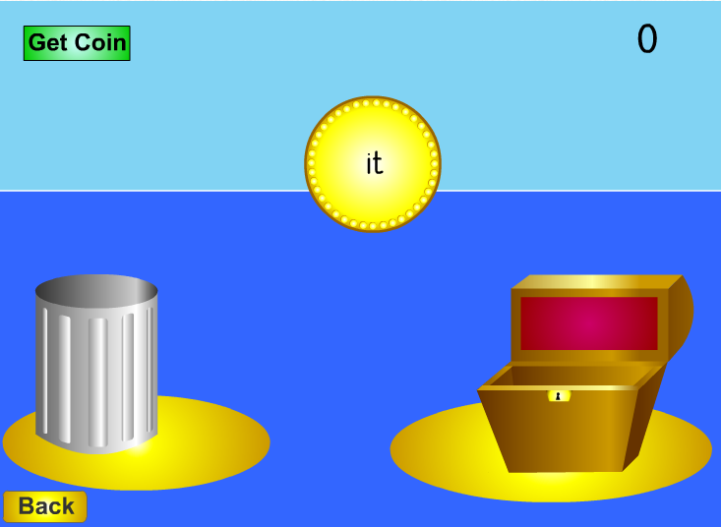
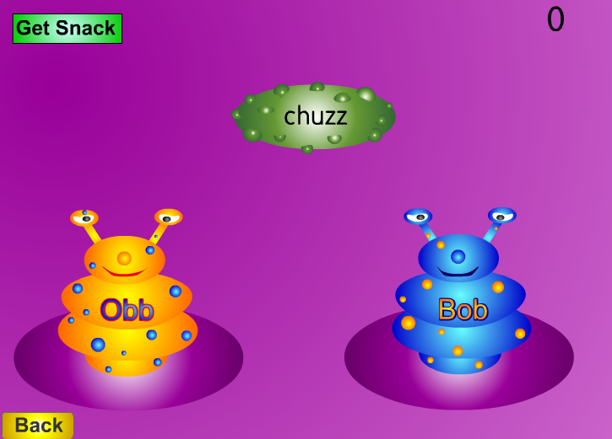
Resources
http://www.phonicsplay.co.uk
For parents | Letters and Sounds (littlewandlelettersandsounds.org.uk)

Slide 46
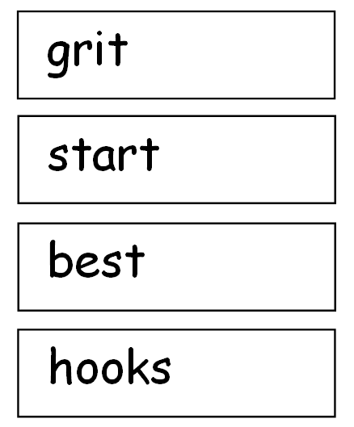
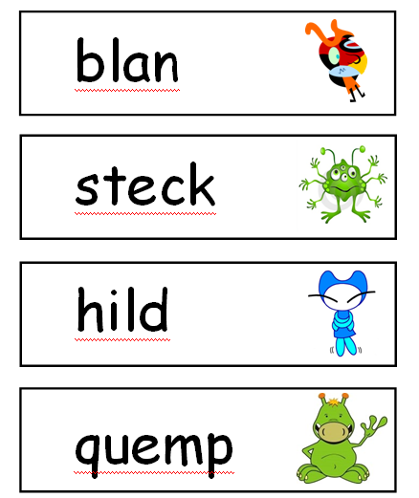
Year 1 Phonics Test

