Slide 1
Y6 Residential Meeting
Kingswood – 19th – 23rd February 2024

Slide 2
Contents
When they are going – times
Where they are going
Activities
What rooms will be like
Food
What to bring
Dos and Don’ts
Questions
Hoodies

Slide 3
When will I get a relaxing week without my 10/11-year-old?
Monday 19th – Friday 23rd February 2024
Please bring your child to school – the coach will pick the children up at 10:30, they will be at Kingswood by lunch.
They will then arrive back to school at 13:15 on the Friday – I am happy for you to come and pick them up then (but you can keep them here until 3:15, let us know either way)
If there are delays we will be in touch.

Slide 4
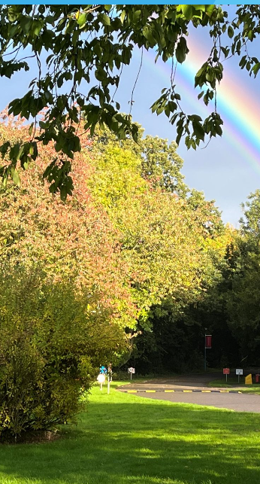
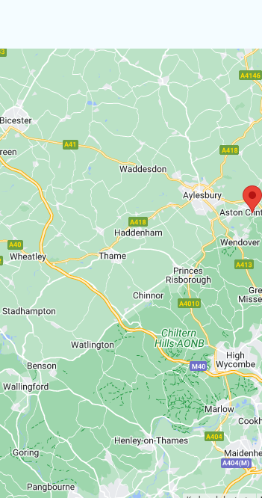
Where they are going
Just outside Aylesbury
Google maps says 55 minutes, so if there is an issue, we are close.
It is in 88 acres of Woodland and
nice and secluded in nature

Slide 5
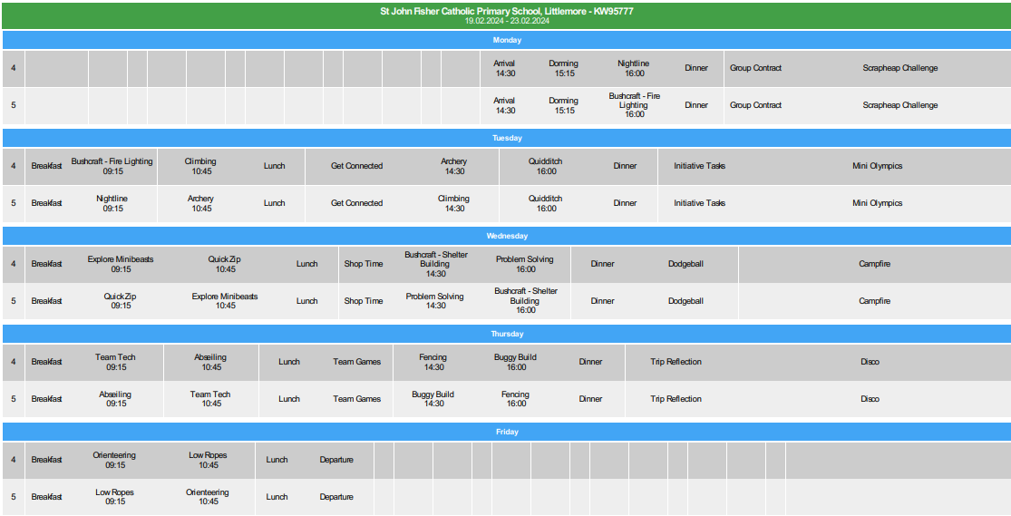

Slide 6

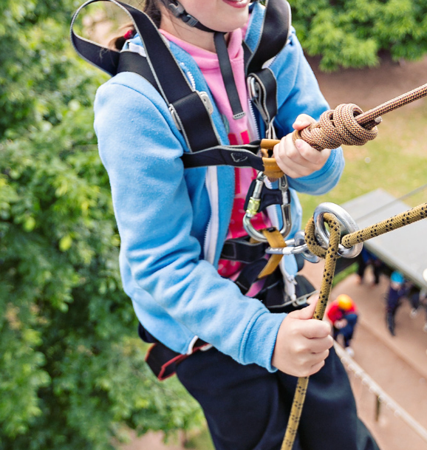


Slide 7
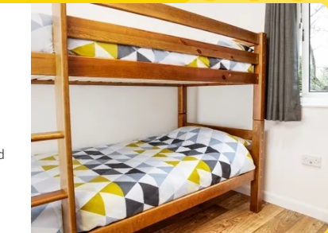
Rooms
Rooms are two children sharing with an adult on each floor
There is an odd number, so there will be one group of 3
We will ensure that children are with an appropriate partner but will not inform them until arrival.

Slide 8

Menu

Slide 9
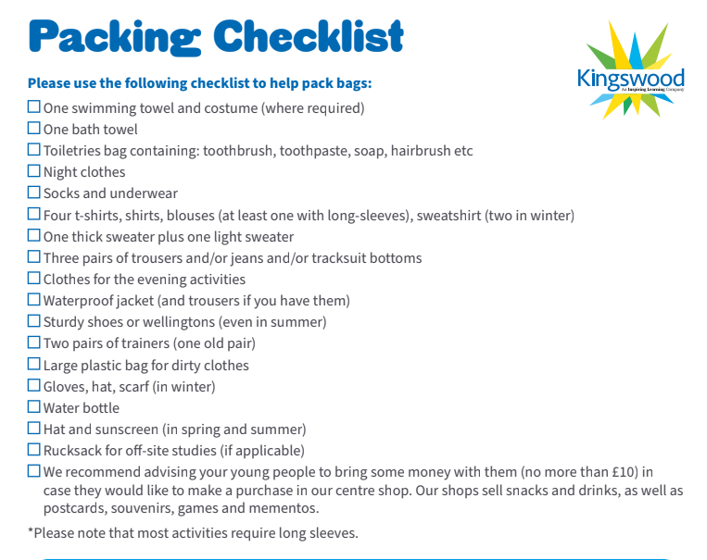
What to bring
Due to the time of year, we are not swimming

Slide 10

Contact
We will have a mobile phone, the number will be shared with all families
Please only contact us in an emergency – If it is during school time, the school office should be your first point of contact
Your child will not be bringing a mobile phone with them.

Slide 11

Medical forms / Allergies
Medical consent forms will be sent out – we can give out medicines, but we need to have it all recorded clearly
We should already know about any allergies, and this will be passed on – if we don’t: please let us know.

Slide 12
Questions?

Slide 13

Hoodies
https://personalised.clothing/stjohnfisheroxford/

