Slide 1

Y4 Residential Meeting
Youlbury Wednesday 24th – Friday 26th April 2024

Slide 2
Contents
When they are going – times
Where they are going
Activities
Accommodation
Food
What to bring
Dos and Don’ts
Questions

Slide 3

Uptake
It is fantastic to be able to run a Y4 residential again at St John Fisher
The uptake has been superb and it is a first step away for a lot of the children here.
It isn’t really about what they do or where they go, it is about being away and creating shared memories

Slide 4

When will they be going
Wednesday 24th– Friday 26th April 2024
Please bring your child to school on Wednesday, they will stay here until lunch and we will be leaving straight after – they will be travelling in taxis!
They will then arrive back to school on Friday, probably around 2pm – I am happy for you to come and pick them up then (but you can keep them here until 3:15, let us know either way)
If there are delays we will be in touch.

Slide 5
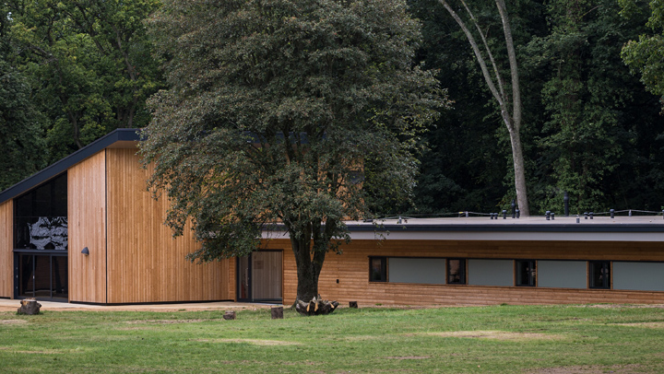
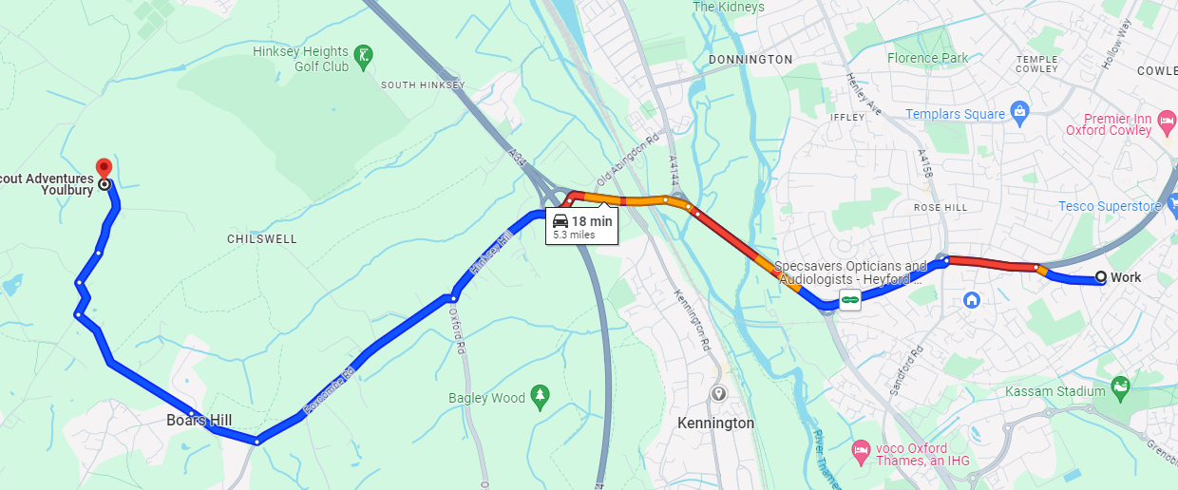
Where they are going
Youlbury is just by Boar’s hill – it is very close!
Google maps says 18 minutes, so if there is an issue, we will contact you
It is a massive site with lots of activities and trails for the children
It is a Scout Centre

Slide 6
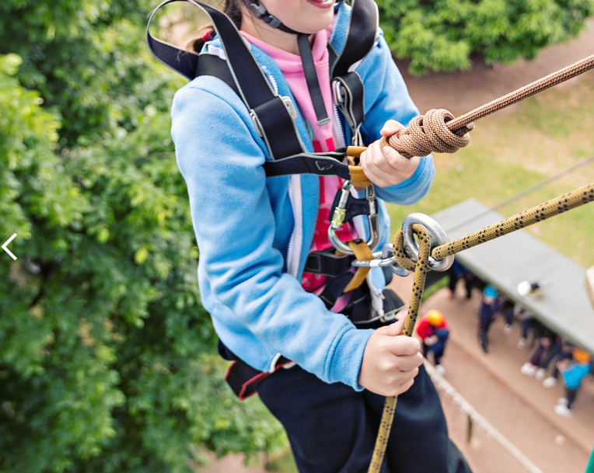
What they are doing
I have been sent a timetable but they are going to be split into two groups, so it isn’t really of value sharing, however activities will include.
Outdoor Cooking
Peddle Kart Racing
Abseiling
Crate building challenge (some sort of climbing thing)
Campfire (all together)
There will be some time where our leaders will choose an activity to lead on also – but they will be able to choose when they are there

Slide 7
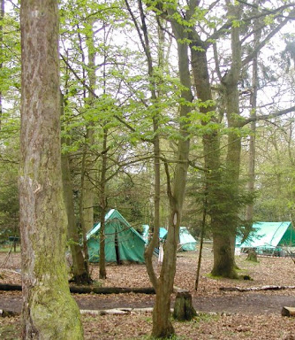
Accommodation
I have signed us up for the ‘Tented Village’
These are large, permanent tents in which there will be something in between a mattress and a camping roll mat to sleep on
You will need to send your child with a sleeping bag and a pillow
The tents can hold up to 5 children each, but there are plenty so we will probably have 3 in a tent – we will sort out who is going with who through our tried and tested method used by every Primary school ever.
We are fully catered and there are indoor areas with toilets etc – but these are 75 metres from the tents, so nighttime will be in nature.

Slide 8
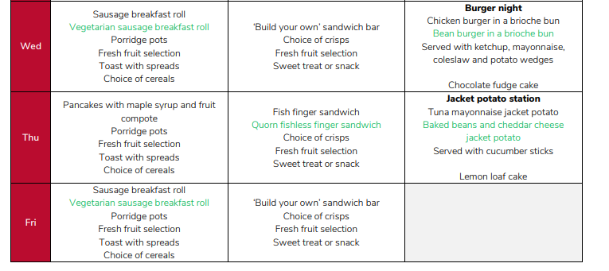
Food
I was sent a sample menu, we should already know your child’s allergies, but please inform us if not.
We will send out medical forms to complete over Easter

Slide 9

Staff
We will have three members of staff
Ms Tordoff, Mrs Turton and one other who does not what their name announced yet, I am not sure why, but she is going.
We will also send up staff in the day to make sure the site is OK, either myself or Ms McCarthy will go up (depending on weather)
All activities are led by trained Scout Leaders with full DBS

Slide 10
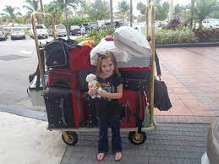


What to bring
Please remember they are there for 2 nights, not 14! You do not need to send them with lots and lots
Sleeping bag and pillow
Trainers and wellies (if wet)
Check the weather before for rain gear, but pack a raincoat
Two changes of clothes
Water bottle
Bedclothes
Toiletries / Towel
TORCH
Please label items
Medicines

Slide 11

Contact
We will have a mobile phone, the number will be shared with all families
Please only contact us in an emergency – If it is during school time, the school office should be your first point of contact
Your child will not be bringing a mobile phone with them.

Slide 12
Behaviour
Youlbury is extremely close, but if we feel a child is not being safe – this will mostly be in regards to refusing to follow instructions, we will contact you to collect them.
If you can’t be contacted, a member of staff will bring them back to school.
This would be a last resort, but the safety of the other children and staff is paramount and we are one adult to a group, so a child refusing to participate removes the group from an activity.

Slide 13

Medical forms / Allergies
Medical consent forms will be sent out – we can give out medicines, but we need to have it all recorded clearly
We should already know about any allergies, and this will be passed on – if we don’t: please let us know.

Slide 14
PAY
If you do not pay in full before departure, your child will not go, even if they are here with their bags.
We will still have to pay for the place, so please talk to us now if there is a problem
Talk to us.

Slide 15
Q
Questions?
I will try my best

