Slide 1


Phonics and Reading
CPD
Tuesday 24th September 2024

Slide 2
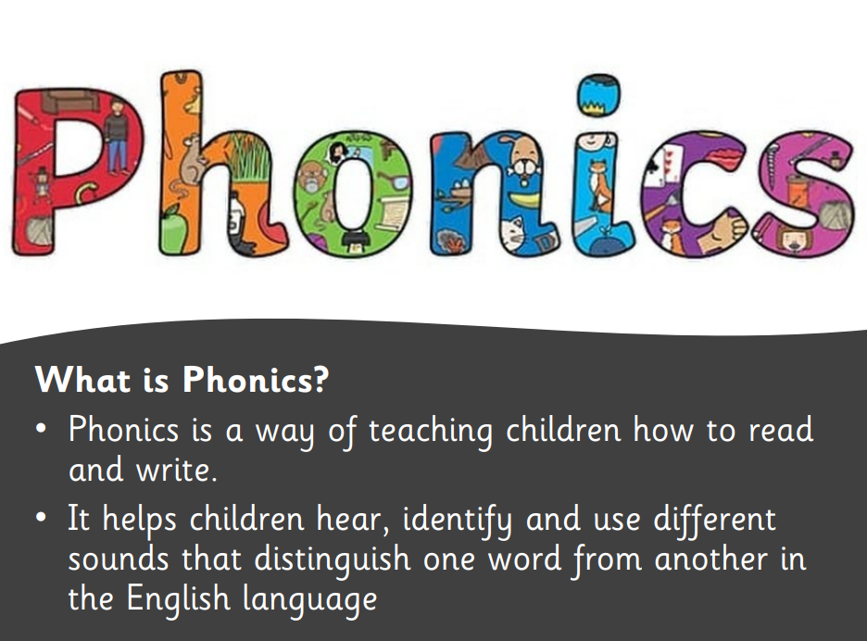

Slide 3
In school, we follow the Little Wandle programme. Little Wandle is a phonics resource published by the Department for Education and Skills.

Slide 4
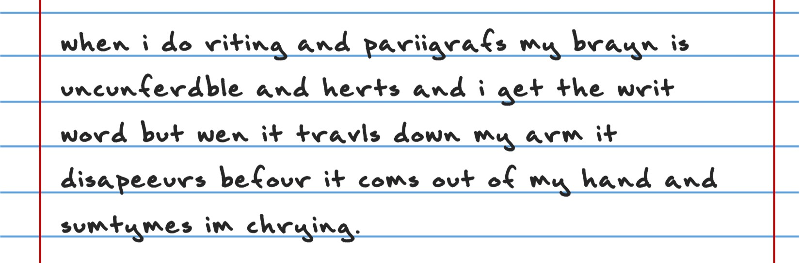
Can you read this?
What do you notice?
What would you need to know about phonics?

Slide 5
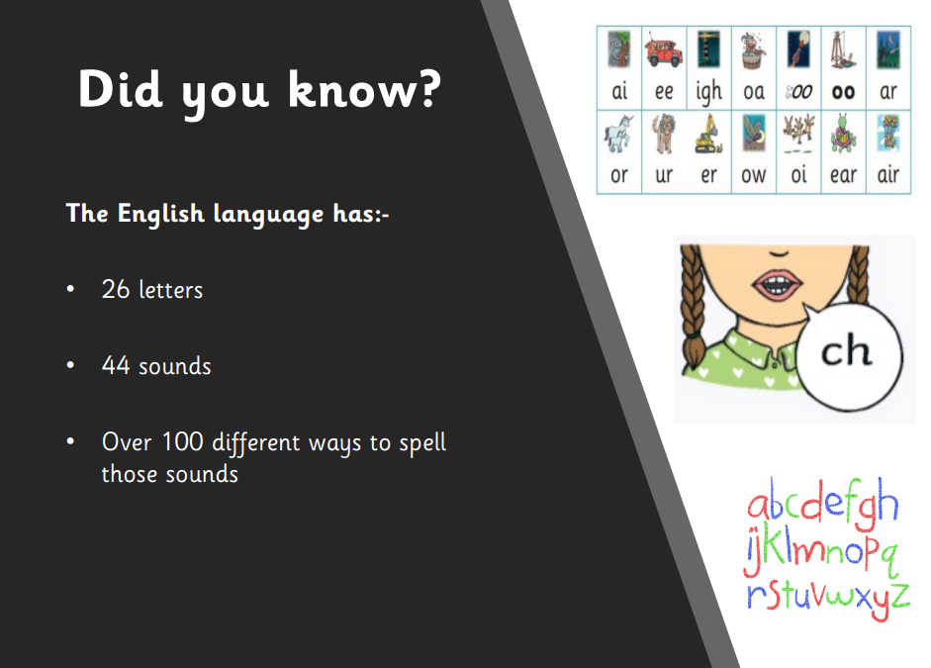

Slide 6
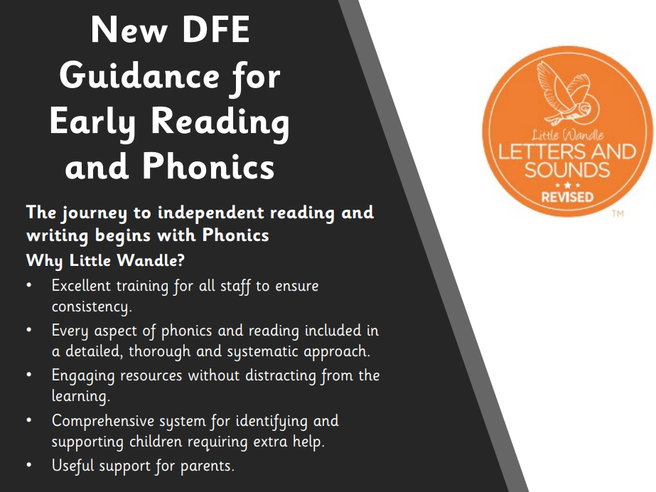

Slide 7
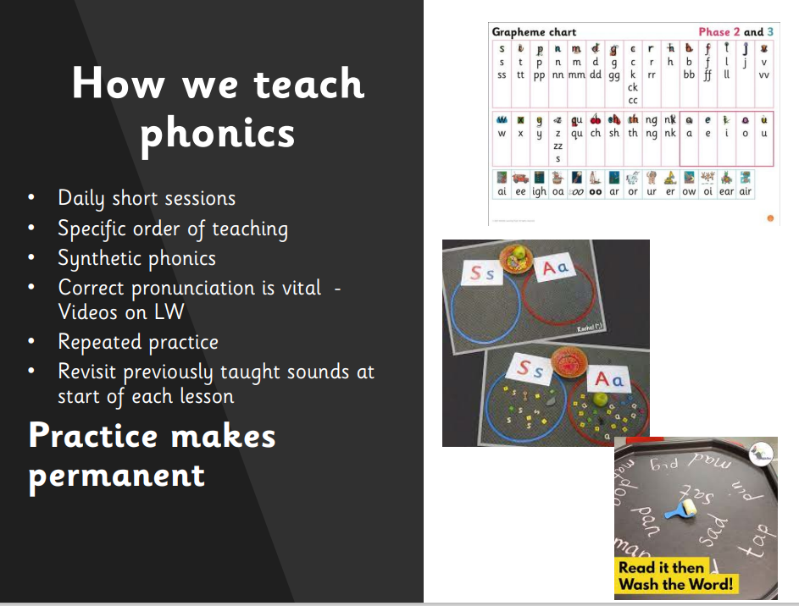

Slide 8
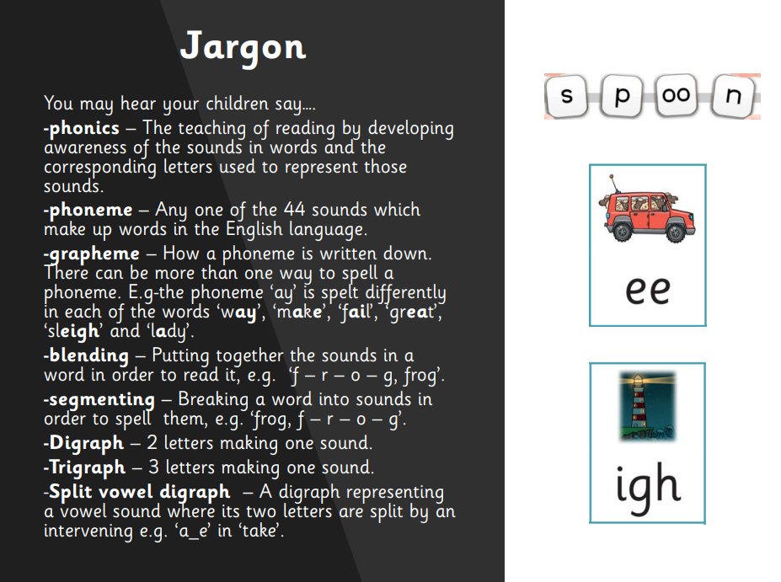

Slide 9
Phase 1
There are 7 aspects with 3 strands.
A1 – Environmental
A2 – Instrumental sounds
A3 – Body Percussion
A4 – Rhythm and rhyme
A5 – Alliteration
A6 – Voice sounds
A7 – Oral blending and segmenting.

Slide 10
Phase 2
Set 1: s, a, t, p
Set 2: i, n, m, d
Set 3: g, o, c, k
Set 4: ck, e, u, r
Set 5: h, b, f, ff, l, ll, ss

Slide 11
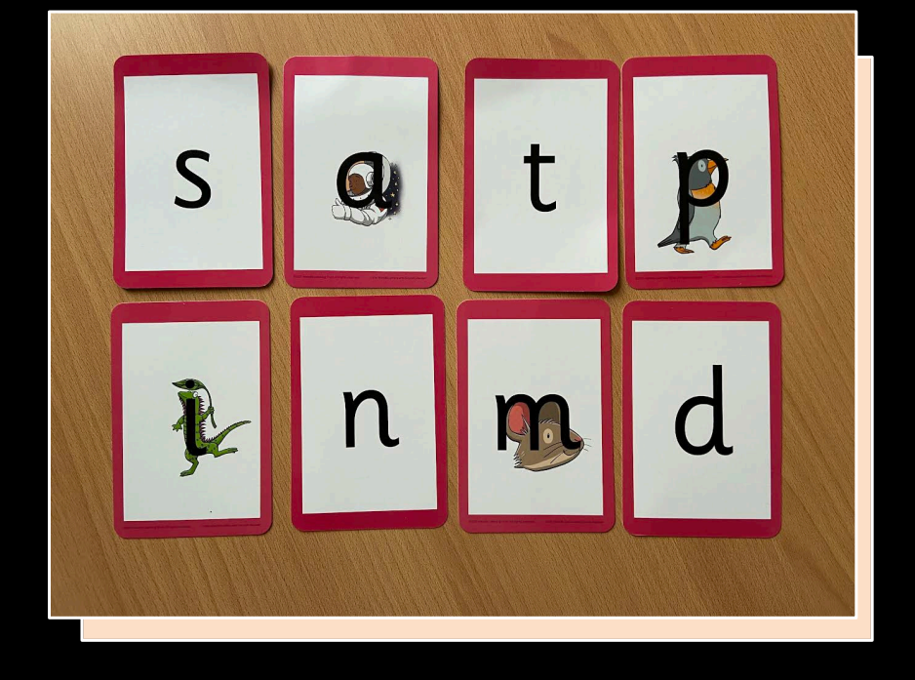

Slide 12
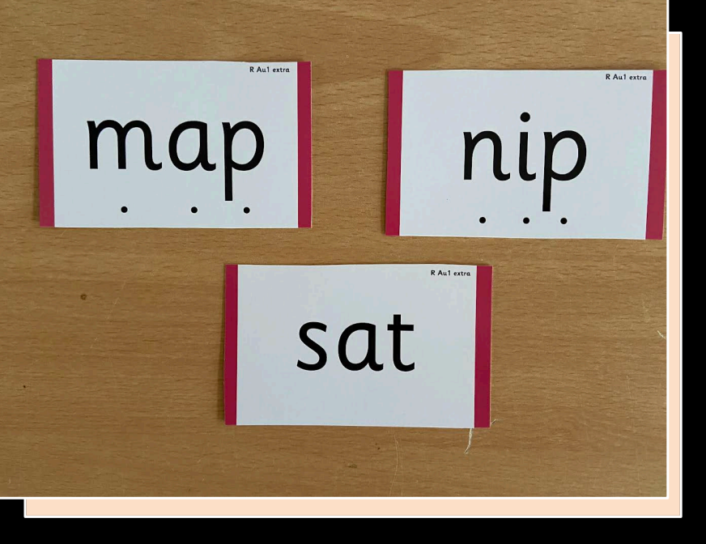

Slide 13
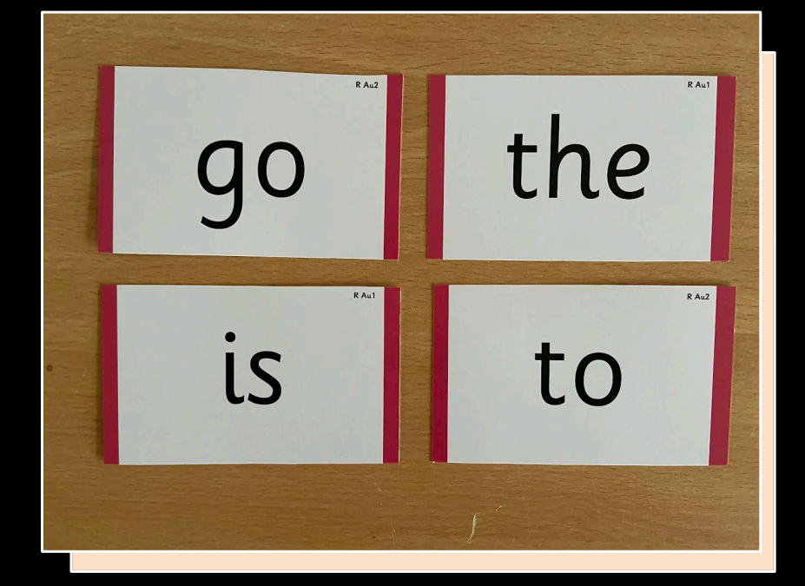

Slide 14
Phase 3
Set 6: j, v, w, x
Set 7: y, z, zz, qu
Consonant digraphs: ch, sh, th, ng
Vowel digraphs: ai, ee, igh, oa, oo, ar, or, ur, ow, oi, ear, air, ure, er

Slide 15
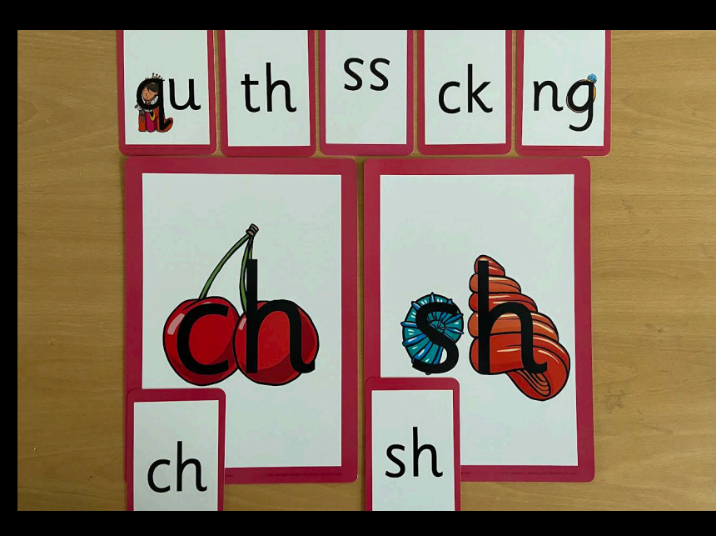

Slide 16
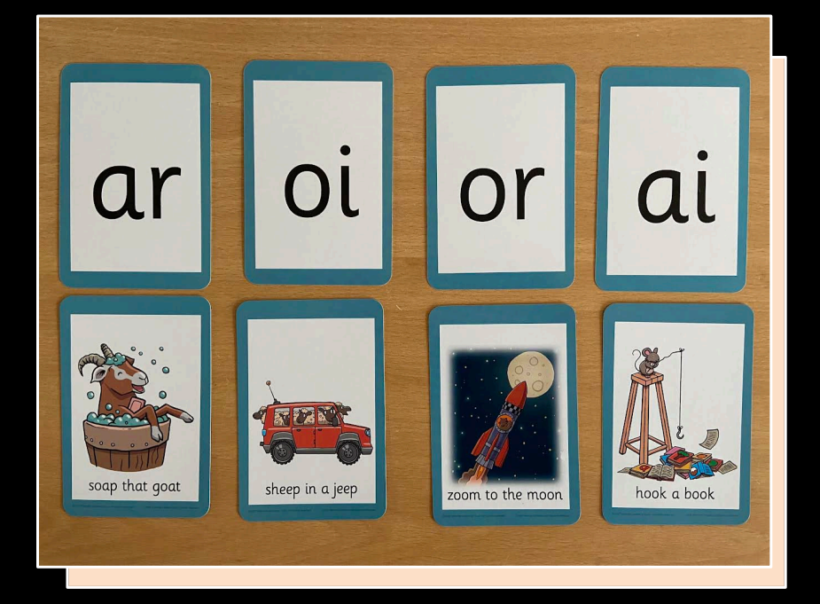

Slide 17
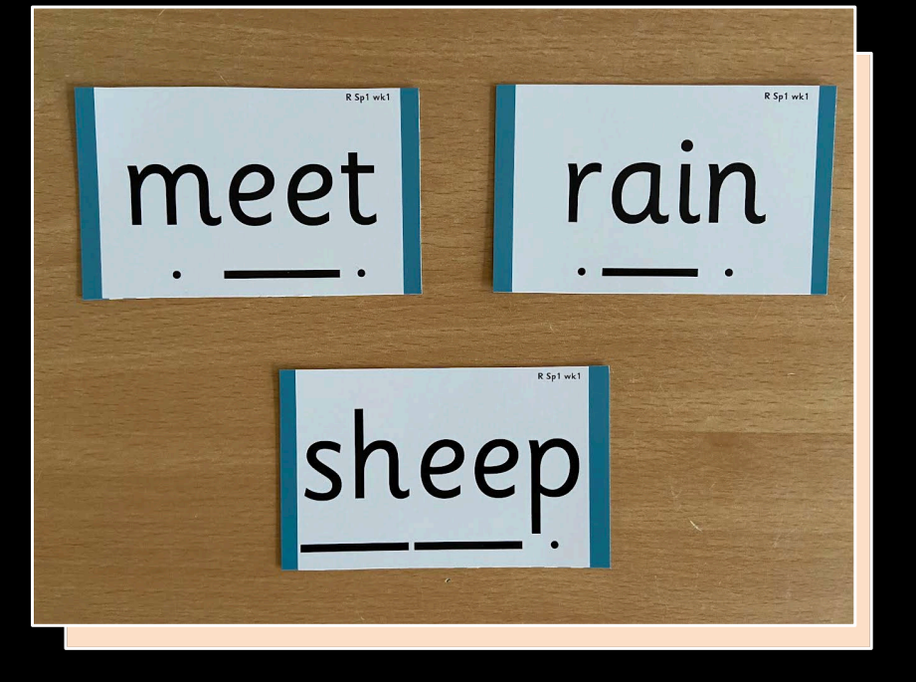

Slide 18
Phase 4
This phase consolidates all the children have learnt in the previous phases.

Slide 19
Phase 5
Children will be taught new graphemes and alternative pronunciations for these graphemes.
Vowel digraphs: wh, ph, ay, ou, ie, ea, oy, ir, ue, aw, ew, oe, au
Split digraphs: a_e, e_e, i_e, o_e, u_e

Slide 20
Phase 6
The focus is on learning spelling rules for suffixes.
-s -es -ing -ed
-er -est -y -en
-ful -ly -ment -ness

Slide 21
Segmenting
Breaking down words for spelling.
cat
c a t

Slide 22
Segmenting
Queen
qu ee n

Slide 23
Blending
Building words from phonemes to read.
c a t
cat

Slide 24
Blending
Qu ee n
queen

Slide 25
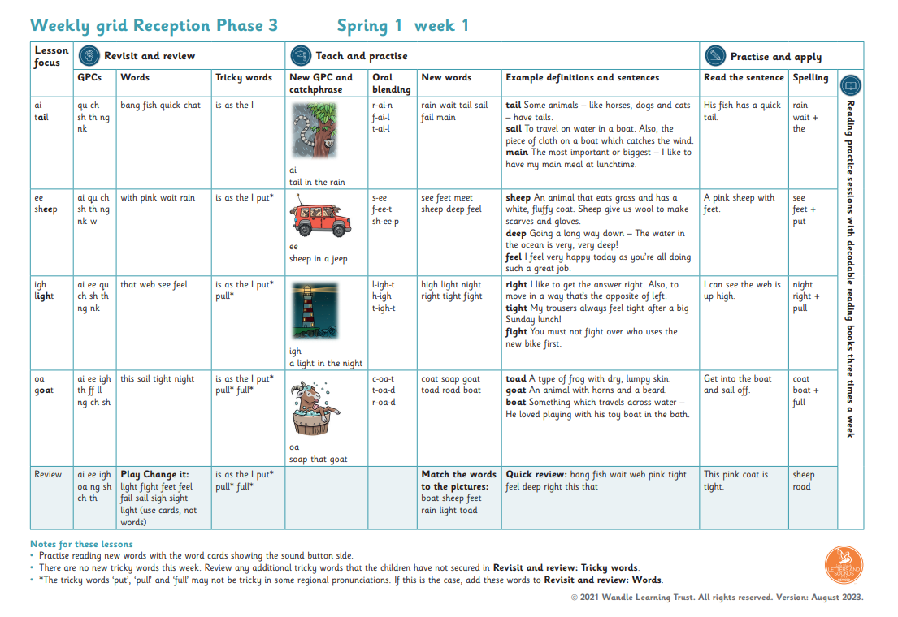
What does a Phonics lesson look like?
Revisit/review | Flashcards to practice phonemes learnt so far.
Teach | Teach new phoneme air
Practice | Buried treasure Air, zair, fair, hair, lair, pair, vair, sair, thair
Apply | Read captions: The goat had a long beard. The quack was right in his ear.

Slide 26
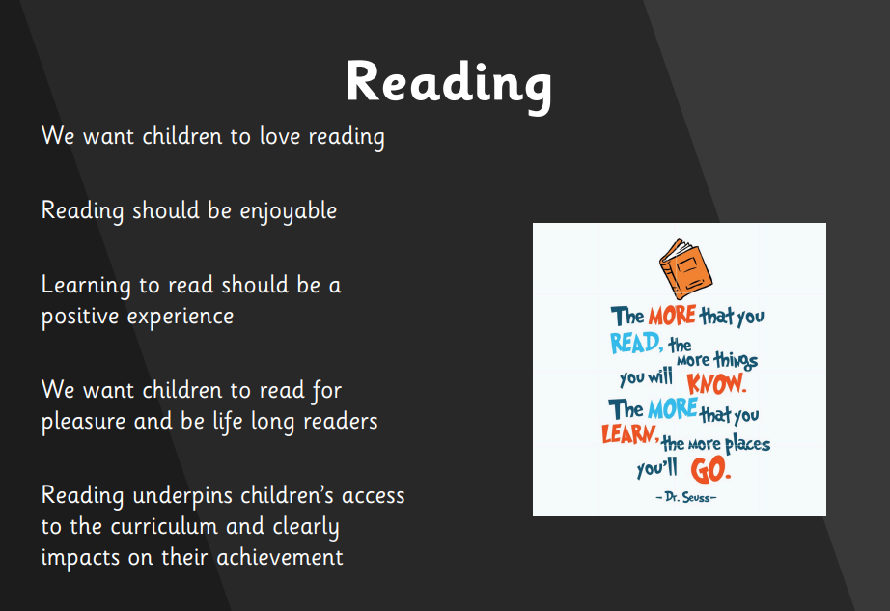

Slide 27
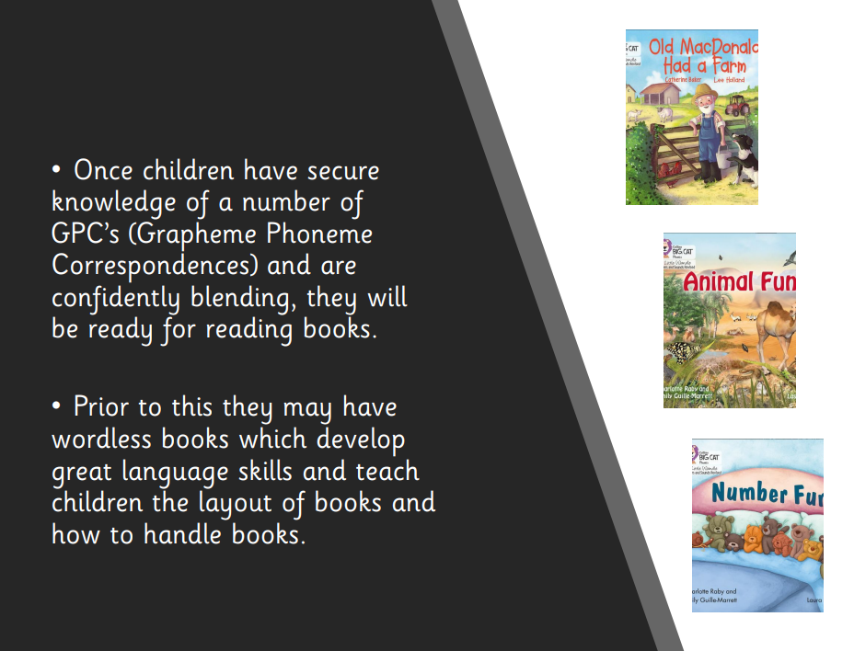

Slide 28
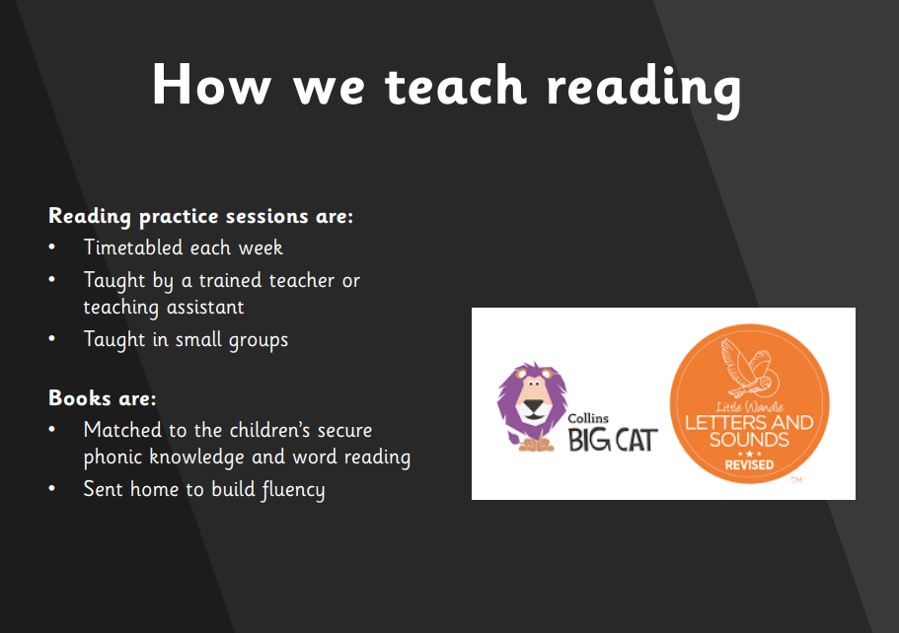

Slide 29
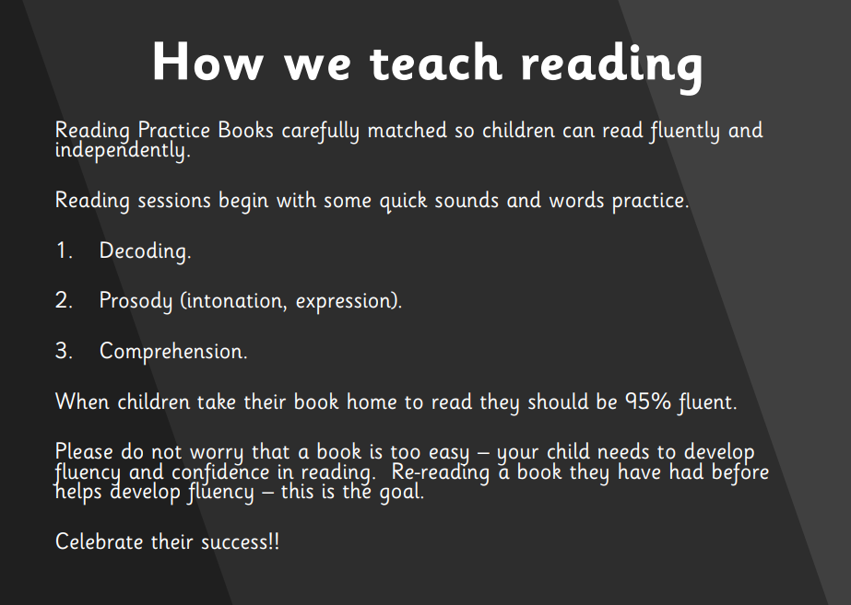

Slide 30
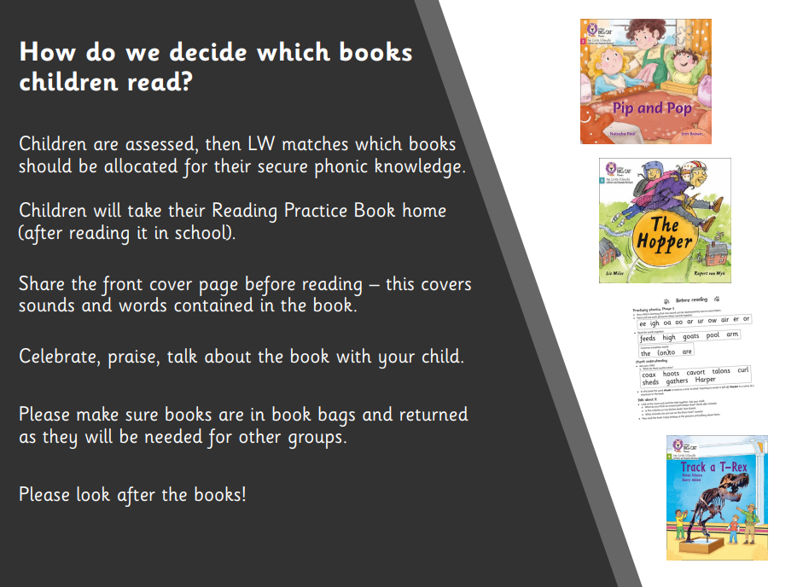

Slide 31

Reading at home

Slide 32
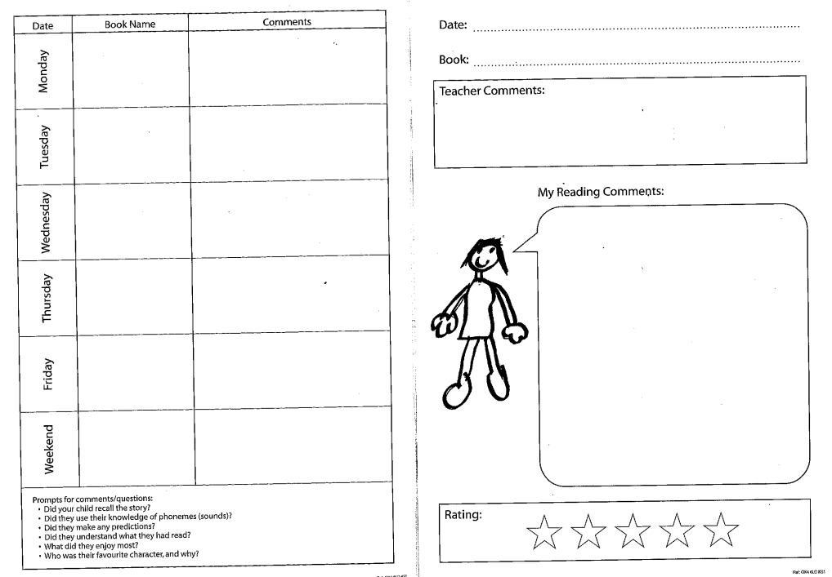
Reading at home

Slide 33
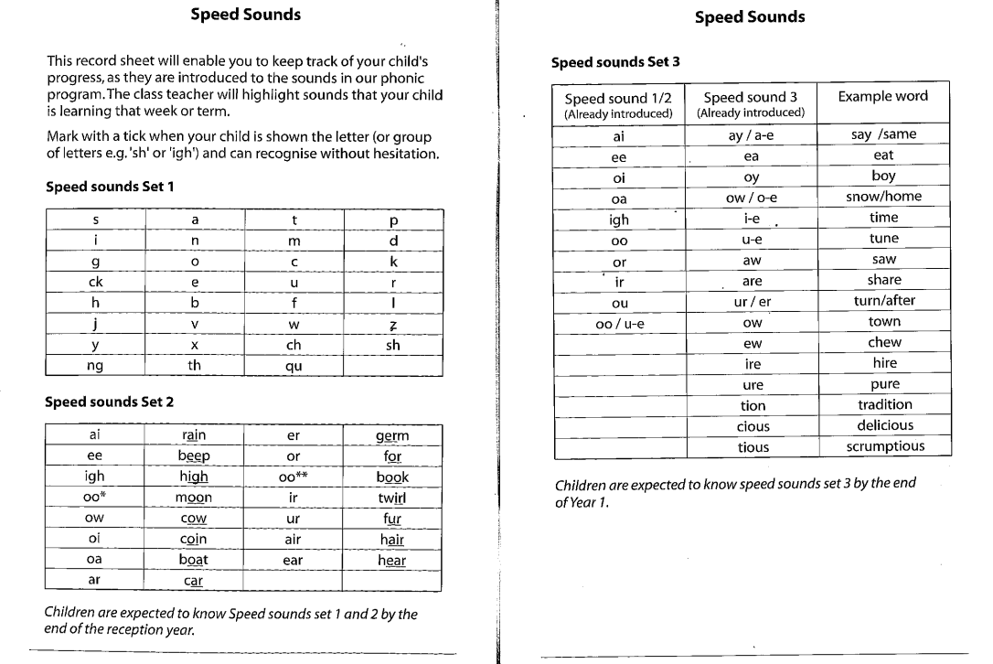
Reading at home

Slide 34
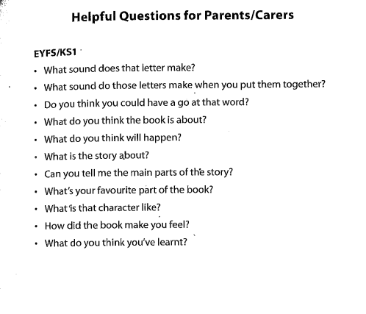
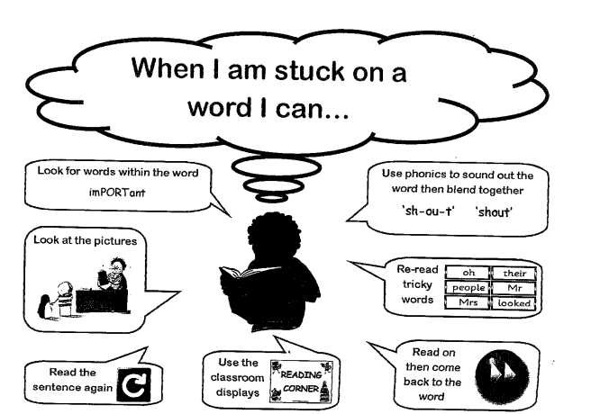
Reading at home

Slide 35
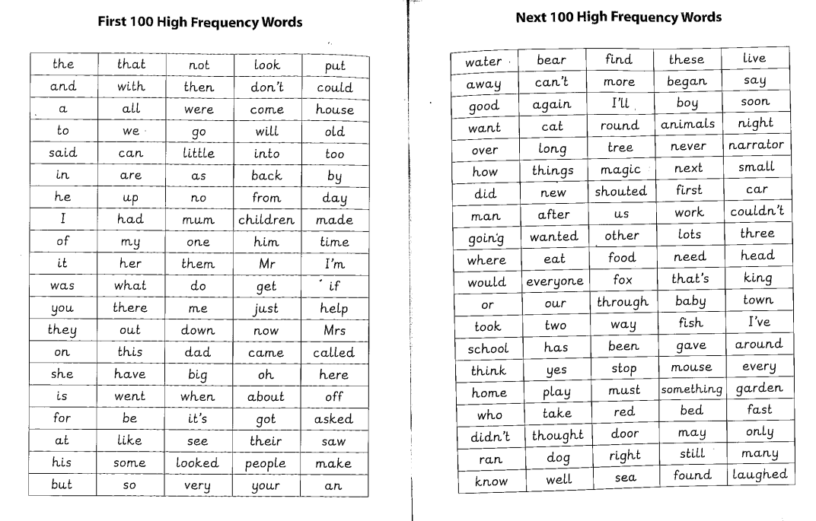
Reading at home

Slide 36
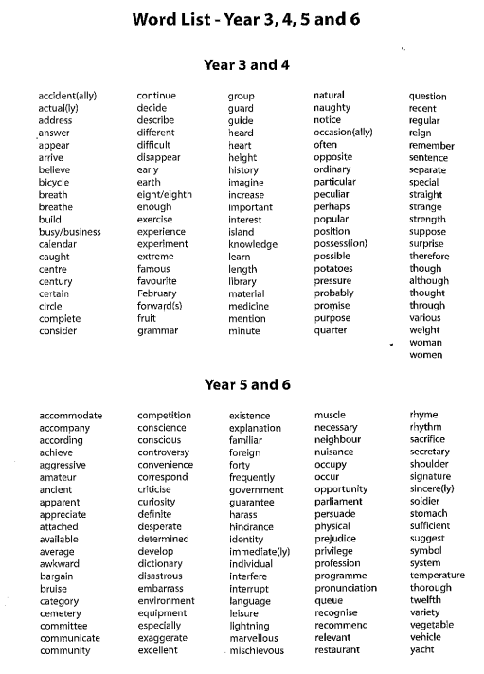

Slide 37
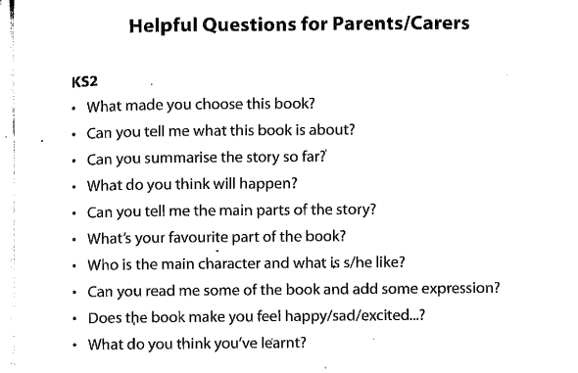

Slide 38
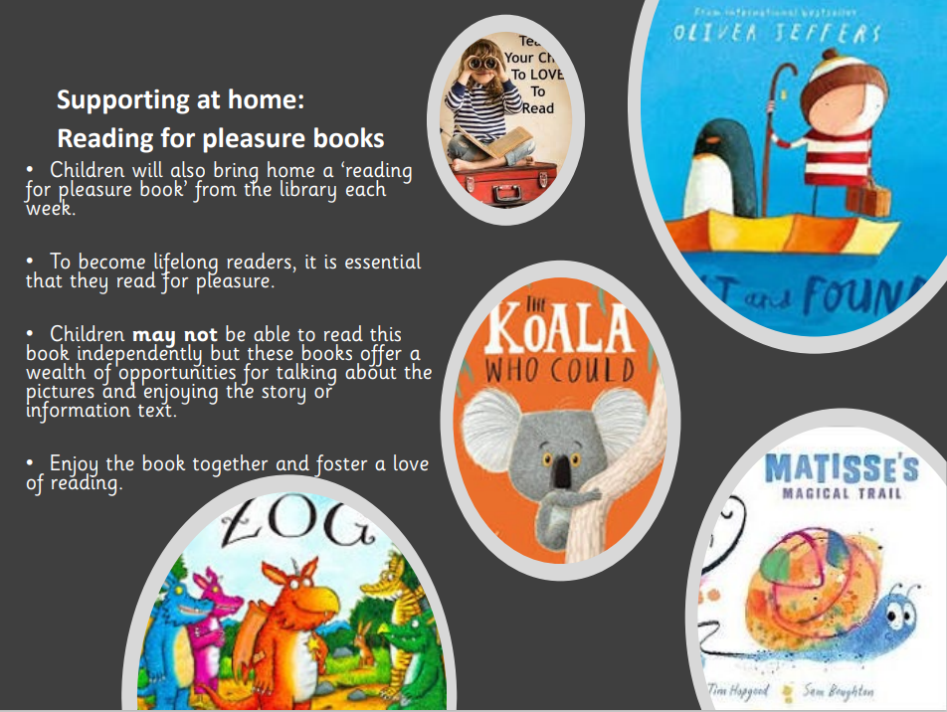

Slide 39
Reading Tree
We want to celebrate reading
Every 25 reads (1 read per day), children will receive a certificate
Every 100 reads- bookmark
Every 200 reads- free trip to the story museum
Every 300 reads- a free book

Slide 40
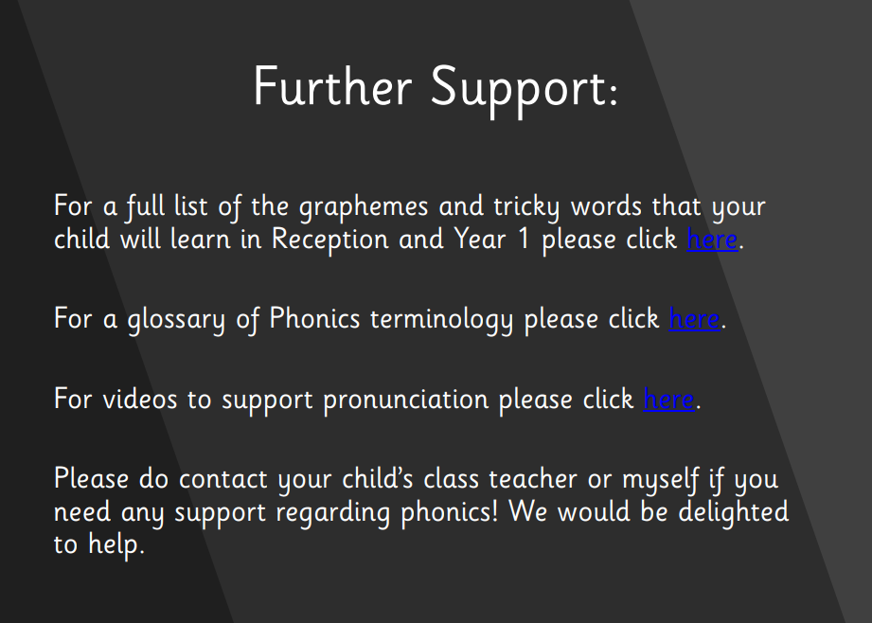

Slide 41
https://www.littlewandlelettersandsounds.org.uk/resources/for-parents/#tabnametabBooksComingHome

Slide 42
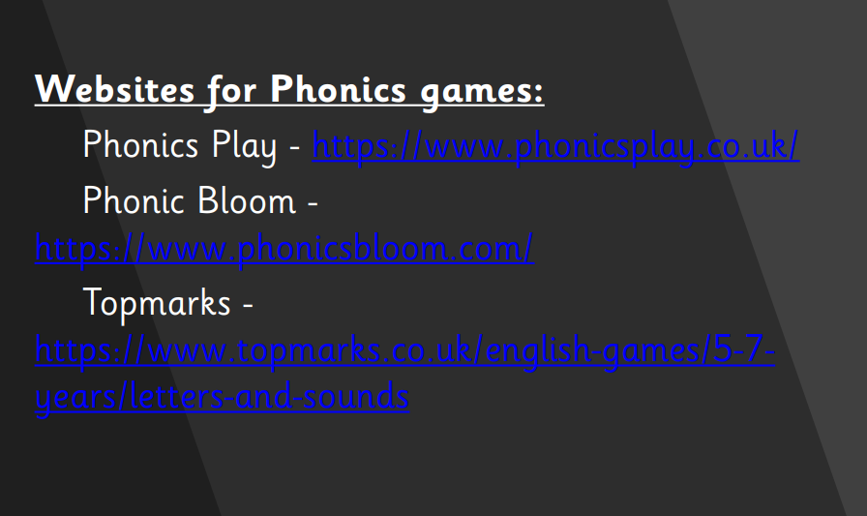

Slide 43
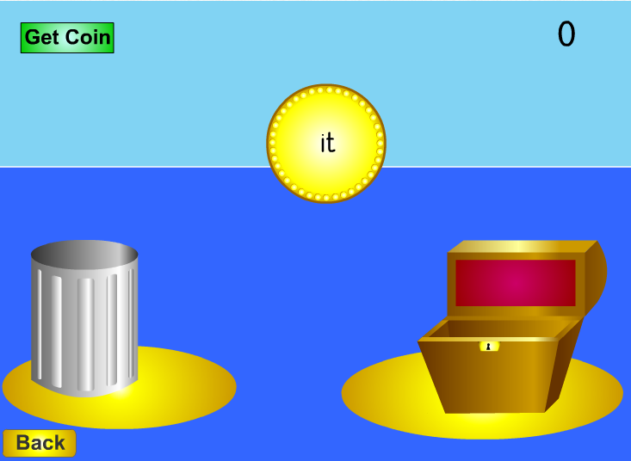
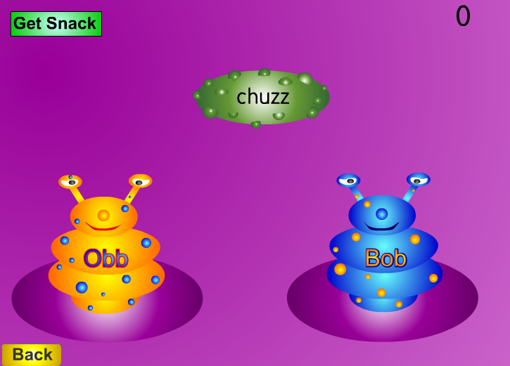
Resources
http://www.phonicsplay.co.uk
For parents | Letters and Sounds (littlewandlelettersandsounds.org.uk)

Slide 44
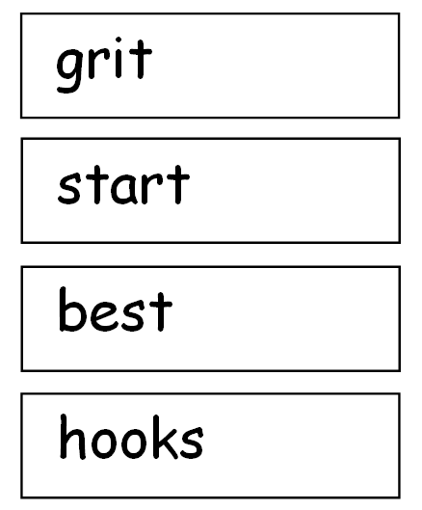
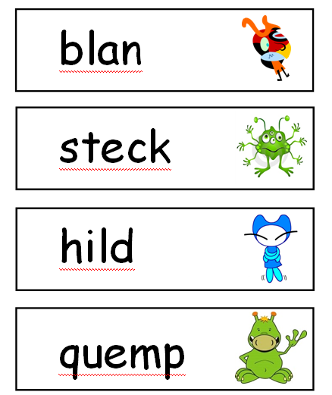
Year 1 Phonics Test

