Slide 1

Y4 Residential Meeting
Youlbury Monday 24th – Wednesday 26th March 2025

Slide 2
Contents
When they are going – times
Where they are going
Activities
Accommodation
Food
What to bring
Dos and Don’ts
Questions

Slide 3
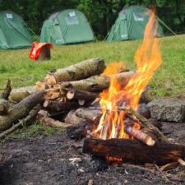
Uptake
It is fantastic to be able to run a Y4 residential again at St John Fisher
The uptake has been superb and it is a first step away for a lot of the children here.
It isn’t really about what they do or where they go, it is about being away and creating shared memories

Slide 4

When will they be going
Monday 24th– Wednesday 26th March 2024
Please bring your child to school on Monday, uniform is not necessary, they will stay here until lunch, and we will be leaving straight after – they will be travelling in taxis!
They will then arrive back to school on Wednesday, probably around 2pm – I am happy for you to come and pick them up then (but you can keep them here until 3:15, let us know either way)
If there are delays, we will be in touch.

Slide 5
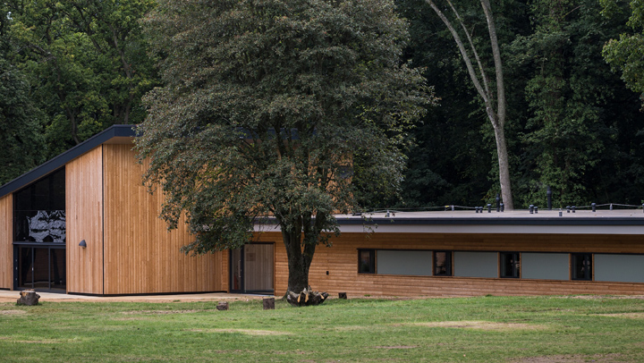
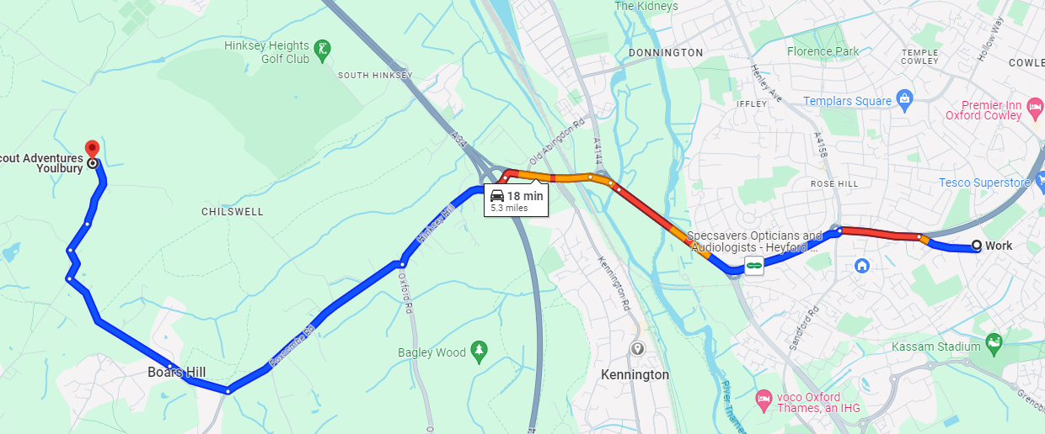
Where they are going
Youlbury is just by Boar’s hill – it is very close!
Google maps says 18 minutes, so if there is an issue, we will contact you
It is a massive site with lots of activities and trails for the children
It is a Scout Centre

Slide 6
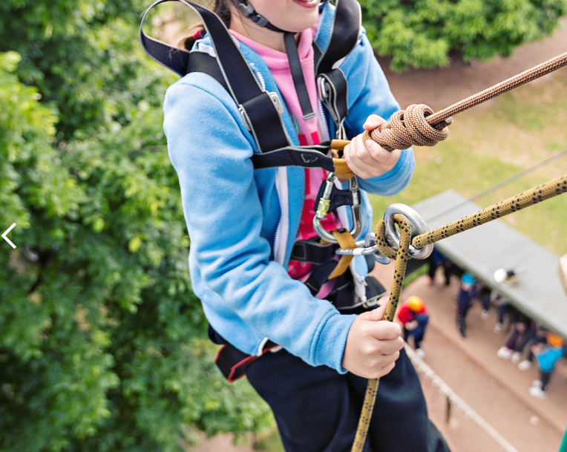
What they are doing
I have been sent a timetable but they are going to be split into two groups, so it isn’t really of value sharing, however activities will include.
Outdoor Cooking
Peddle Kart Racing
Abseiling
Crate building challenge (some sort of climbing thing)
Campfire (all together)
There will be some time where our leaders will choose an activity to lead on also – but they will be able to choose when they are there

Slide 7
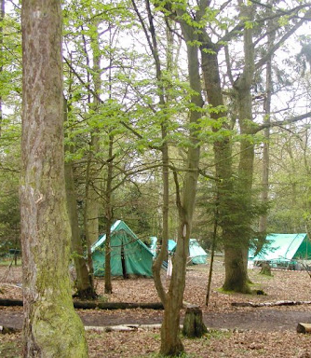
Accommodation
Centenary Lode
Your children will be staying in dorm rooms with bunk beds, with no more than 5 in a room.
The accommodation is secure and we will be the only school in that building.
Children will find out who they will be sharing with when they arrive, but we know the children, so it will be fine.
Please bring sleeping bags.

Slide 8
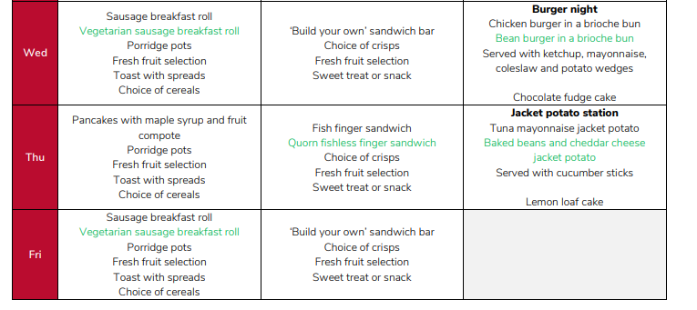
Food
I was sent a sample menu, we should already know your child’s allergies, but please inform us if not.
We will send out medical forms to complete

Slide 9

Staff
We will have three members of staff
Mrs O'Neill, Mrs Risby and Mrs Turton will all be onsite for the duration of the visit.
We will also send up staff in the day to make sure the site is OK, either myself or Ms McCarthy will go up (depending on weather)
All activities are led by trained Scout Leaders with full DBS

Slide 10
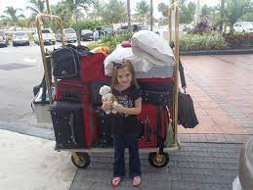


What to bring
Please remember they are there for 2 nights, not 14! You do not need to send them with lots and lots
Sleeping bag and pillow
Trainers and wellies (if wet)
Check the weather before for rain gear, but pack a raincoat
Two changes of clothes
Water bottle
Bedclothes
Toiletries / Towel
TORCH
Please label items
Medicines

Slide 11

Contact
We will have a mobile phone, the number will be shared with all families
Please only contact us in an emergency – If it is during school time, the school office should be your first point of contact
Your child will not be bringing any mobile phones or smart tech with them.

Slide 12
Behaviour
Youlbury is extremely close, but if we feel a child is not being safe – this will mostly be in regards to refusing to follow instructions, we will contact you to collect them.
If you can’t be contacted, a member of staff will bring them back to school.
This would be a last resort, but the safety of the other children and staff is paramount and we are one adult to a group, so a child refusing to participate removes the group from an activity.

Slide 13

Medical forms / Allergies
Medical consent forms will be sent out – we can give out medicines, but we need to have it all recorded clearly
Please can we have labelled medicine in a clear given to us the morning of the trip.
We should already know about any allergies, and this will be passed on – if we don’t: please let us know.

Slide 14
PAY
If you do not pay in full before departure, your child will not go, even if they are here with their bags.
We will still have to pay for the place, so please talk to us now if there is a problem
Talk to us.

Slide 15
Q
Questions?
I will try my best

