Slide 1

Meet the teacher!
2025-2026

Slide 2

Welcome to St Vincent de Paul (Year 6)!
Teacher: Miss Perrin
TA: Mr Keith (Morning)

Slide 3
Overview of this presentation
Our timetable
No Homework
SATS
Routines and systems
Trips
Walking Home/Phones
Key dates
Secondary schools
Parent/Teacher communication procedures

Slide 4
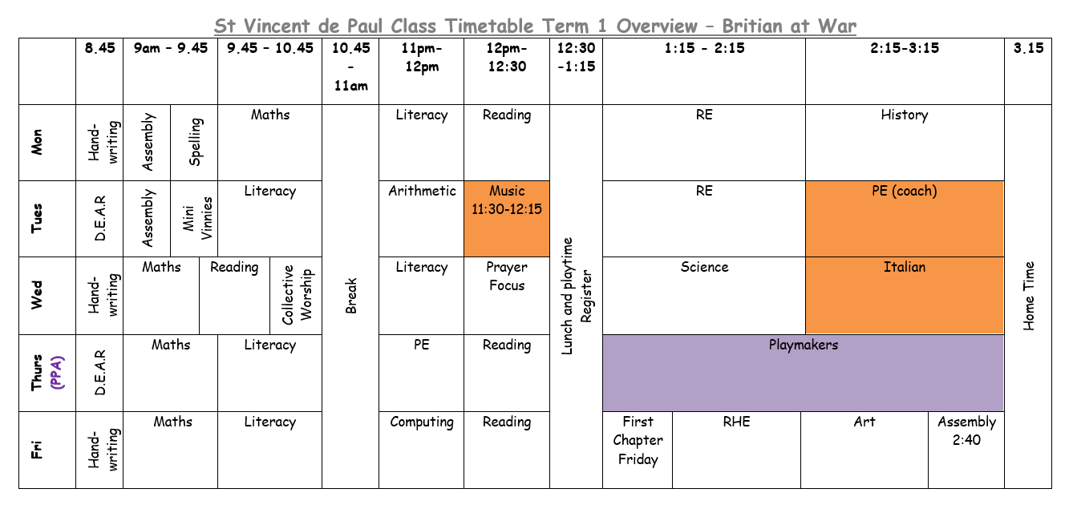
Our Timetable

Slide 5
NO Homework
We are now a No Homework school.
We still expect that reading is competed at home to earn 25 reads and so on.
Reading record check every Tues.
Topic information on the website
Times table rockstars

Slide 6
SATS
The dates for the KS2 SATs normally run over a one week period.
In 2026 the KS2 SATs will take place in 11th – 14th May.
Over this period pupils will sit 6 different tests: Reading, Grammar, Spelling, Arithmetic and two reasoning tests.
More information to come nearer the time.

Slide 7
PE
PE will happen every Tuesday and Thursday for an hour with the PE Teacher.
PE kit must be a red T-shirt and black shorts/joggers.
Hoodies can be brought with for a colder day, must be school colours.
Black (plain)

Slide 8
Pencil Cases
Pencil cases is a big topic in year 6.
The children are currently earning the right to have their own pencil cases.
When this happens further details will be sent out as to what they need.
NO Pencil cases at the moment.
Nothing from home needs to come into school.

Slide 9
Trips
We are going to PGL Liddington this year 15th – 18th May .
https://adventureholidays.pgl.co.uk/camps/liddington/
Deposit payment must be made by 18th Friday £40. We have 21 children so far! Paid fully by 8th May.
Further details and information will follow once we have final numbers.
Mass tomorrow 9:30 BDB
Next Wednesday Blenheim Palace STEM all day
23rd curiosity cube at Greyfriars

Slide 10
Walking Home
If you wish for your child to walk home, you need Collect a letter to sign at the end of this meeting.
I will receive a list of children who are allowed to walk home alone.
Please remember once they leave the school gates, they are no longer our responsibility.
Letters were sent out/ask office if need a new one.

Slide 11
Mobile Phones
Mobile phones are not permitted in school.
However, if you feel your child needs one because they are walking home then it will be handed into the office daily for safety.

Slide 12
Key Dates for Secondary Schools
12th Sept – application open
31st Oct – application closing
2nd March – national offer day
16-17th March – final response date
https://www.oxfordshire.gov.uk/residents/schools/apply-school-place/year-7-applications

Slide 13
Secondary school Open Evenings
Local Schools:
Greyfriars - Thursday 2nd October 2025, 6.00pm - 8.00pm
The Oxford Academy – 24th September 5pm - 7pm
There are some private school around the area which you wish consider. Bursaries with entrance exams.
    Oxford high (girls)
    Madglen collage (boys)
School websites often have open days advertised.

Slide 14
Parent / Teacher Communication
Parent/Teacher partnership
Parent evenings – Autumn Term
  15 and 20th Oct
Parent evenings – Spring Term
Reports – Summer Term
Open door policy – please make contact via the school office by e-mail/telephone.
Please do not hesitate to arrange meeting me if needs be.

Slide 15
Any questions?

Slide 16
Thank you for coming!

